Slide 1
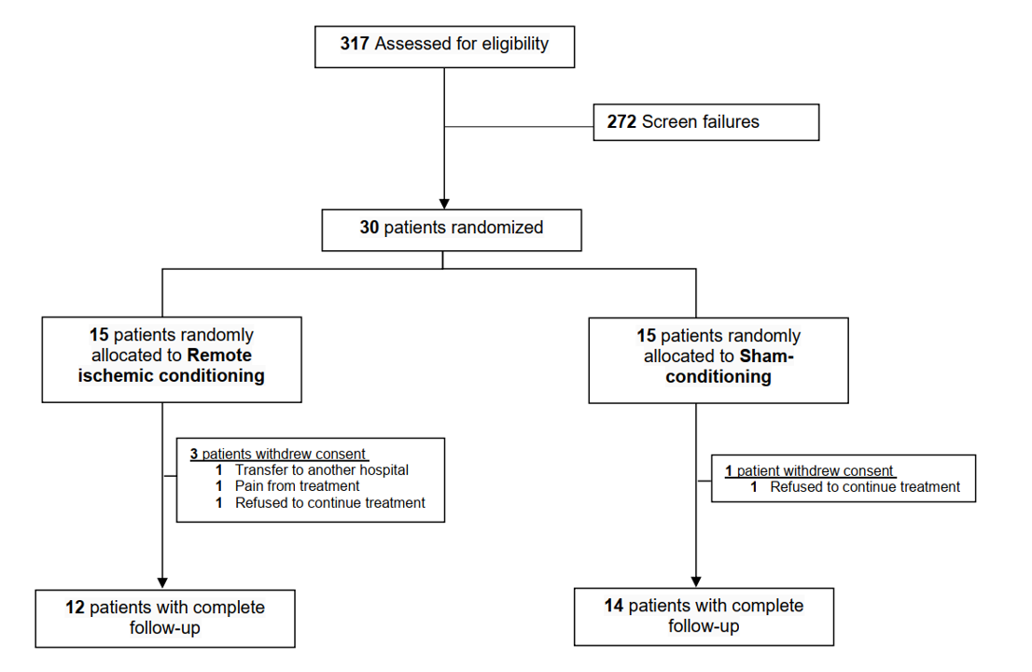
Figure 1.
Kjølhede et al., Conditioning Medicine 2023; 6(6): 208-213.

