Slide 1
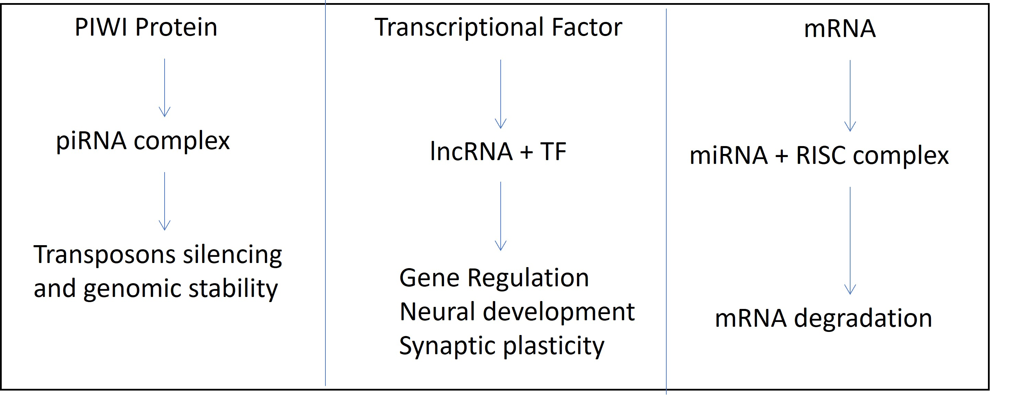
Figure 4.
Patil et al., Conditioning Medicine 2023; 6(3): 88-97.

