Slide 1
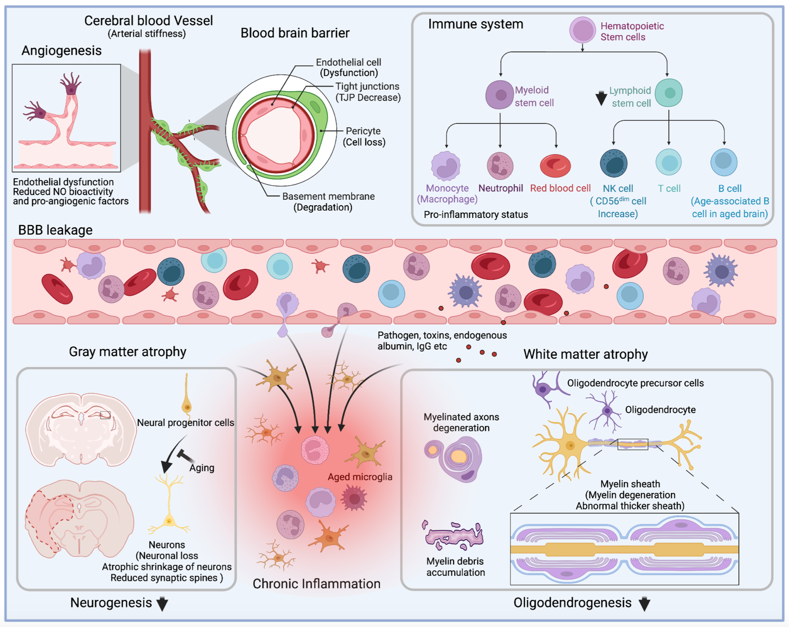
Figure 1.
Zhang et al., Conditioning Medicine 2022; 5(2):59-69.

