Slide 1
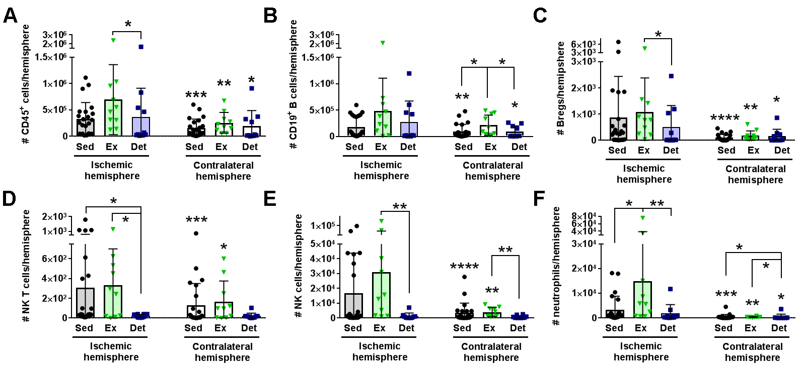
Figure 5. Detraining suppresses leukocyte diapedesis into the brain 3 days after stroke.
Poinsatte et al., Conditioning Medicine 2019; 2(2):50-60.

