Slide 1
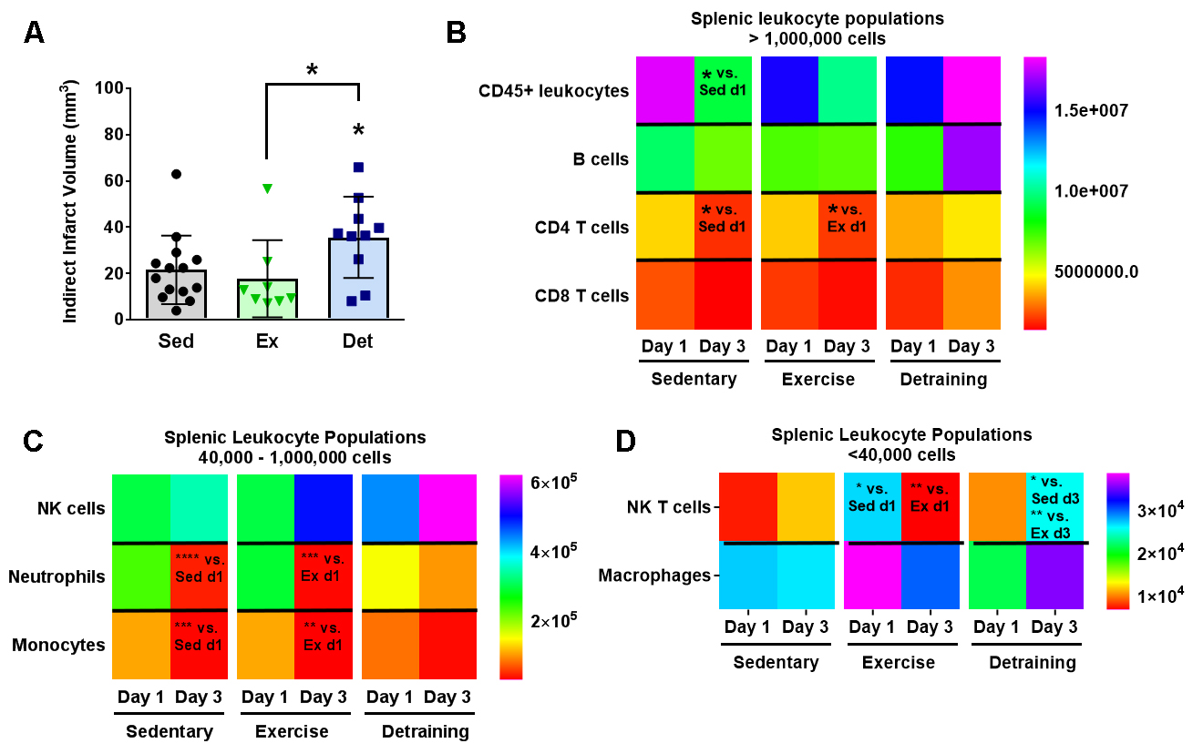
Figure 4. Detraining after voluntary exercise increases infarct volumes and splenic T cells.
Poinsatte et al., Conditioning Medicine 2019; 2(2):50-60.

