Slide 1
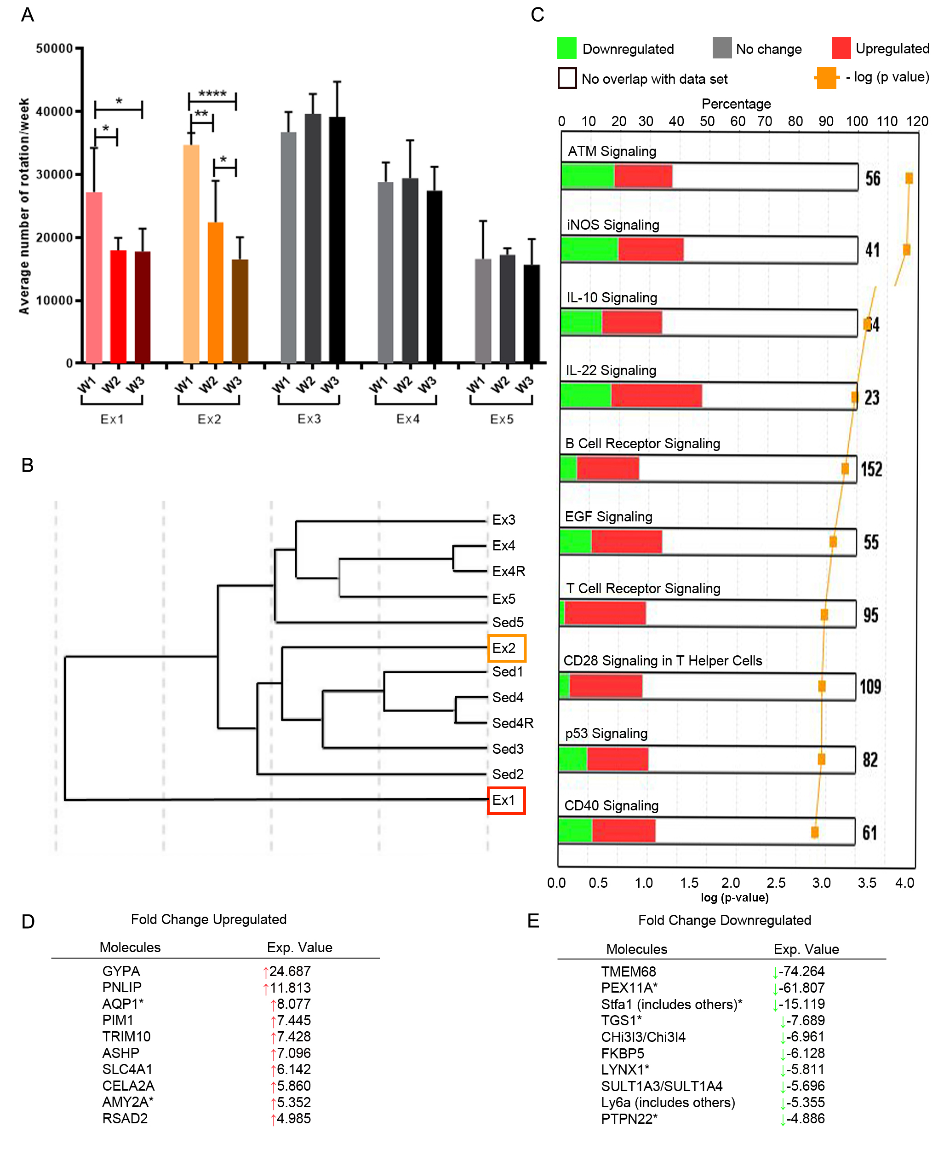
Figure 3. B cell gene expression is altered by consistent exercise.
Poinsatte et al., Conditioning Medicine 2019; 2(2):50-60.

