Slide 1
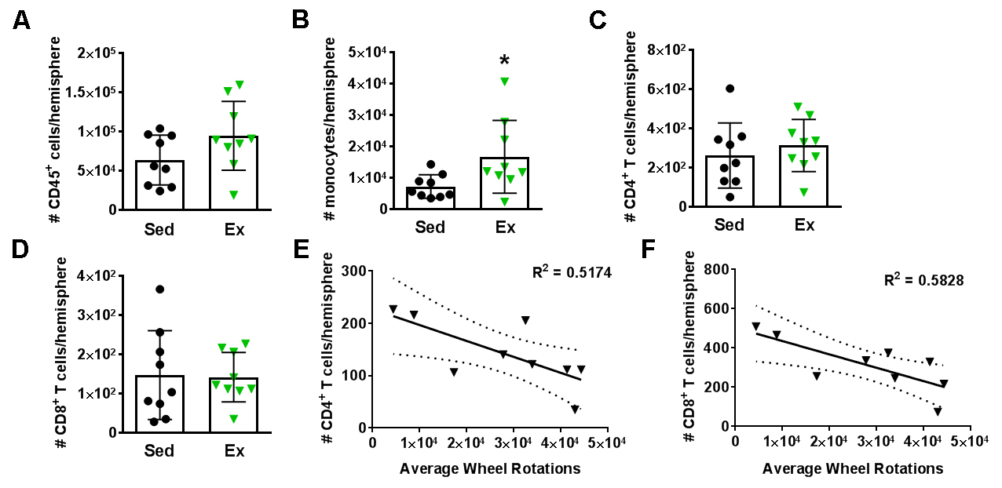
Figure 2. High intensity voluntary exercise reduces T cells in the brain.
Poinsatte et al., Conditioning Medicine 2019; 2(2):50-60.

