Slide 1
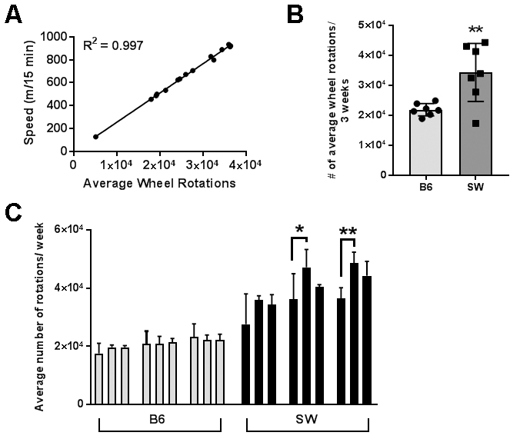
Figure 1. Outbred mice exhibit higher exercise intensity.
Poinsatte et al., Conditioning Medicine 2019; 2(2):50-60.

