Slide 1
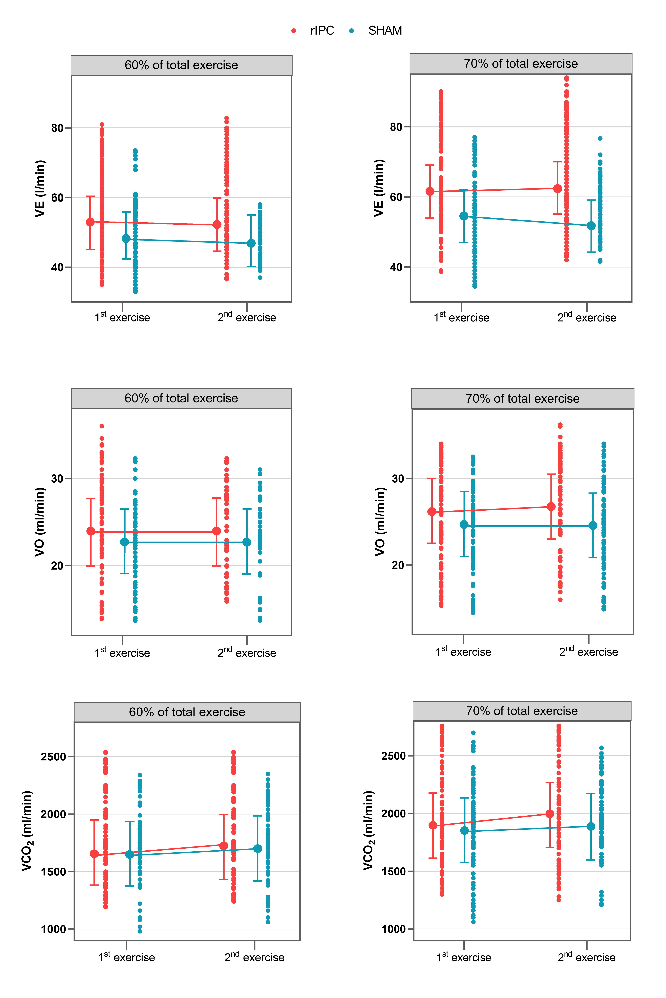
Figure 3. Values of VE (l/min), VO2 (ml/min/kg), and VCO2 (ml/min) during the 1st and 2nd exercises. Points connected by lines are the mean adjusted values estimated by the models (acronyms as in the text).
Gaspard et al., Conditioning Medicine 2021; 4(4):198-208.

