Slide 1
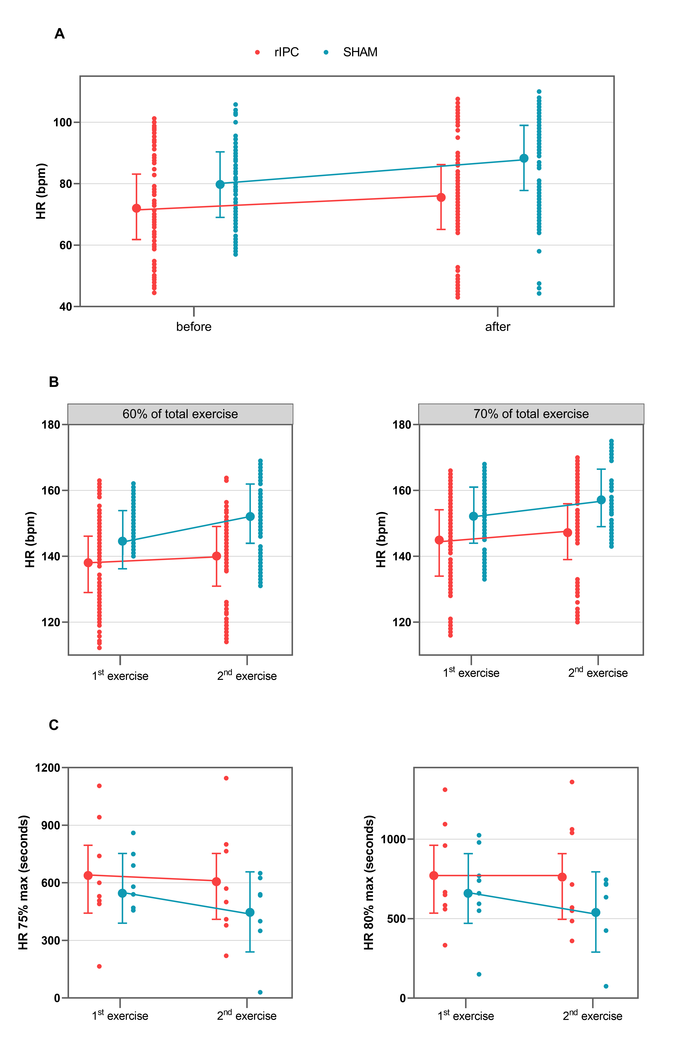
Figure 2. A: Values of HR (bpm) before and 2-h after the 1st exercise. B: Values of HR (bpm) during the 1st and 2nd exercises at 60% and 70% of TET. C: Values of time (seconds) at 75-80% of HRmax-pred during the 1st and 2nd exercises. Points connected by lines are the mean adjusted values estimated by the models (acronyms as in the text).
Gaspard et al., Conditioning Medicine 2021; 4(4):198-208.

