Slide 1
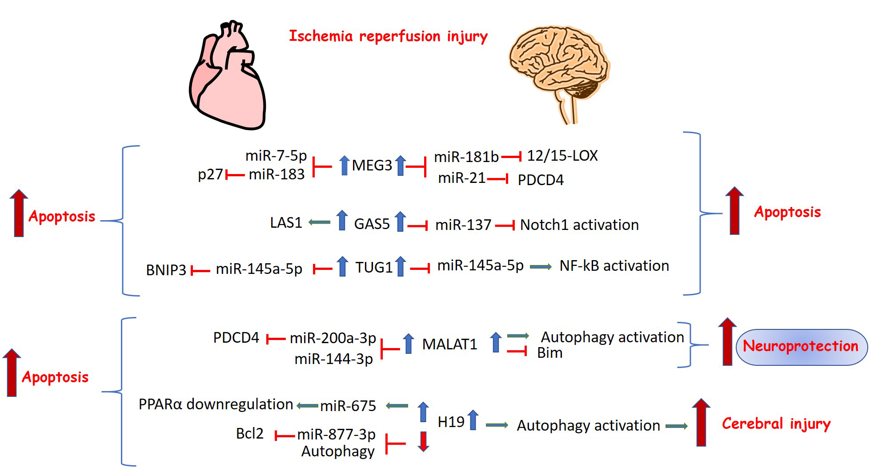
Figure 2. Long noncoding RNAs with common regulation and function in cerebral and myocardial I/R injury.
Eleftheria Galatou and Antigone Lazou, Conditioning Medicine 2020; 3(1):47-57.

