Slide 1
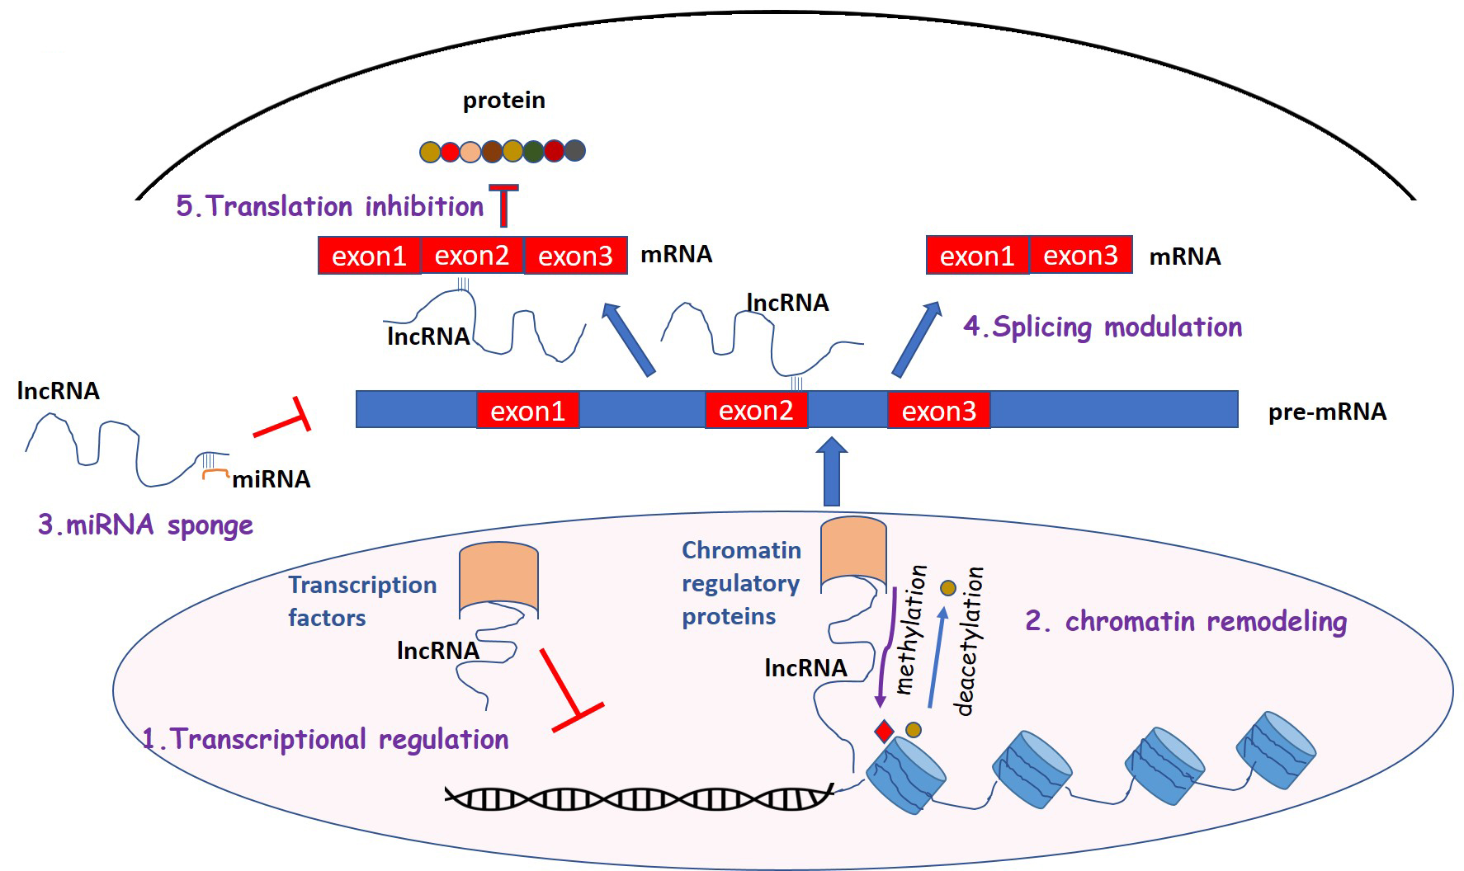
Figure 1. Mechanisms of lncRNA functions.
Eleftheria Galatou and Antigone Lazou, Conditioning Medicine 2020; 3(1):47-57.

