Slide 1
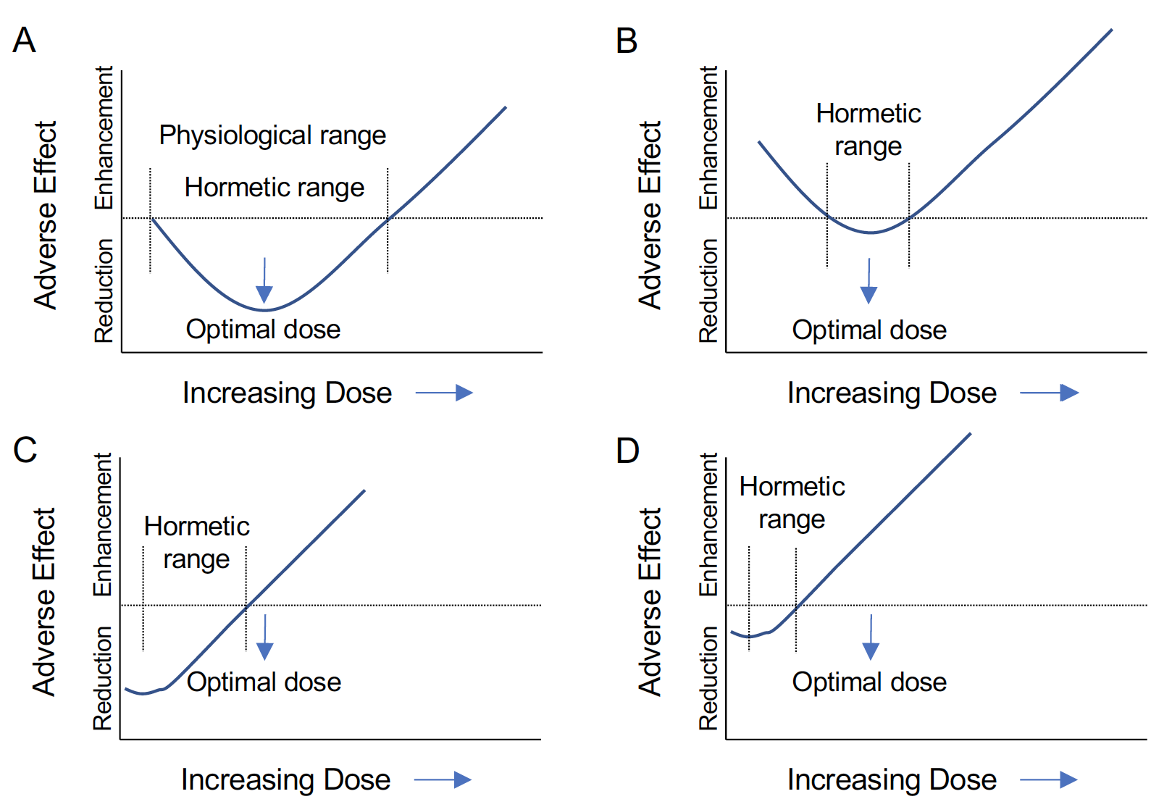
Figure 2. Shifts in the steroid hormone hormetic curve may lead to detrimental effects.
Sun et al., Conditioning Medicine 2019; 2(1):62-74.

