Slide 1
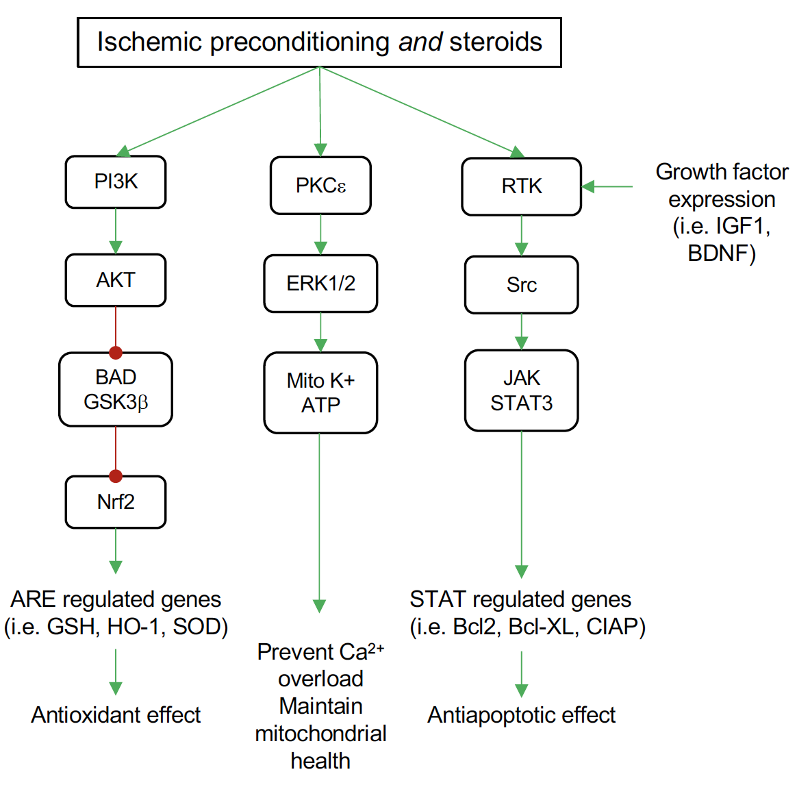
Figure 1. Common pathways for ischemic preconditioning (IPC) and steroid neuroprotection by pretreatment in the brain.
Sun et al., Conditioning Medicine 2019; 2(1):62-74.

