Slide 1
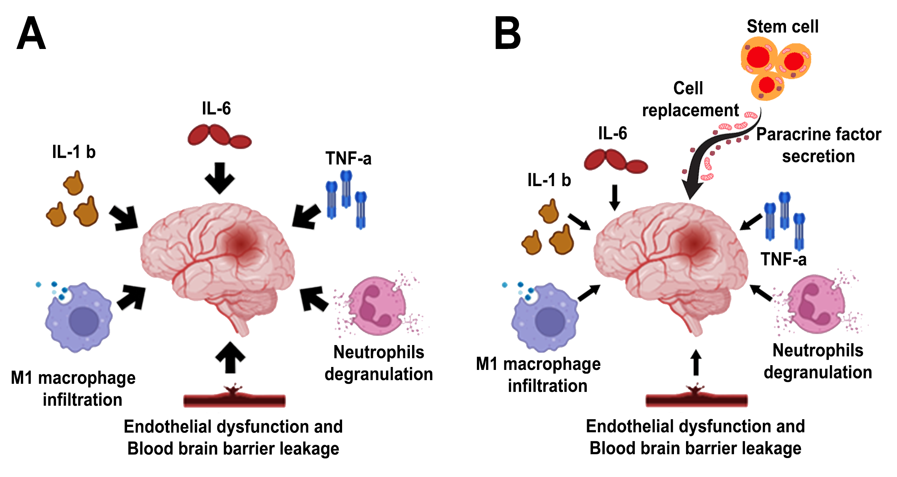
Figure 1.
Salazar et al., Conditioning Medicine 2023; 6(5): 165-169.

