Slide 1
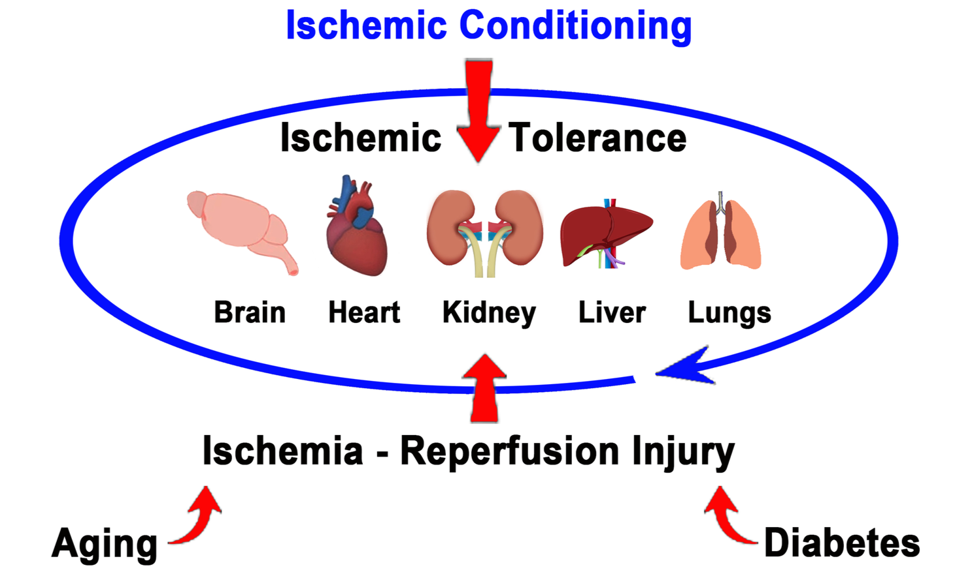
Figure 1.
Maximillian C. Borlongan and Jea-Young Lee, Conditioning Medicine 2023; 6(1): 11-14.

