Slide 1
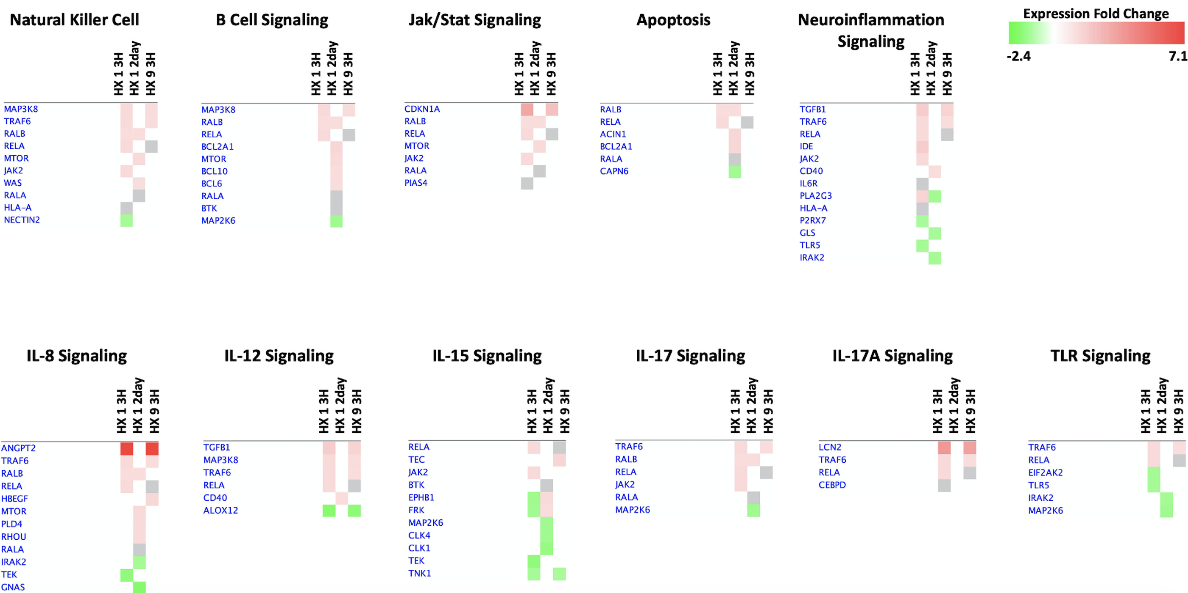
Figure 7. Comparison Analyses’ heatmaps of immunoregulatory genes in the three preconditioned experimental groups.
Harman et al., Conditioning Medicine 2021; 4(1):58-68.

