Slide 1
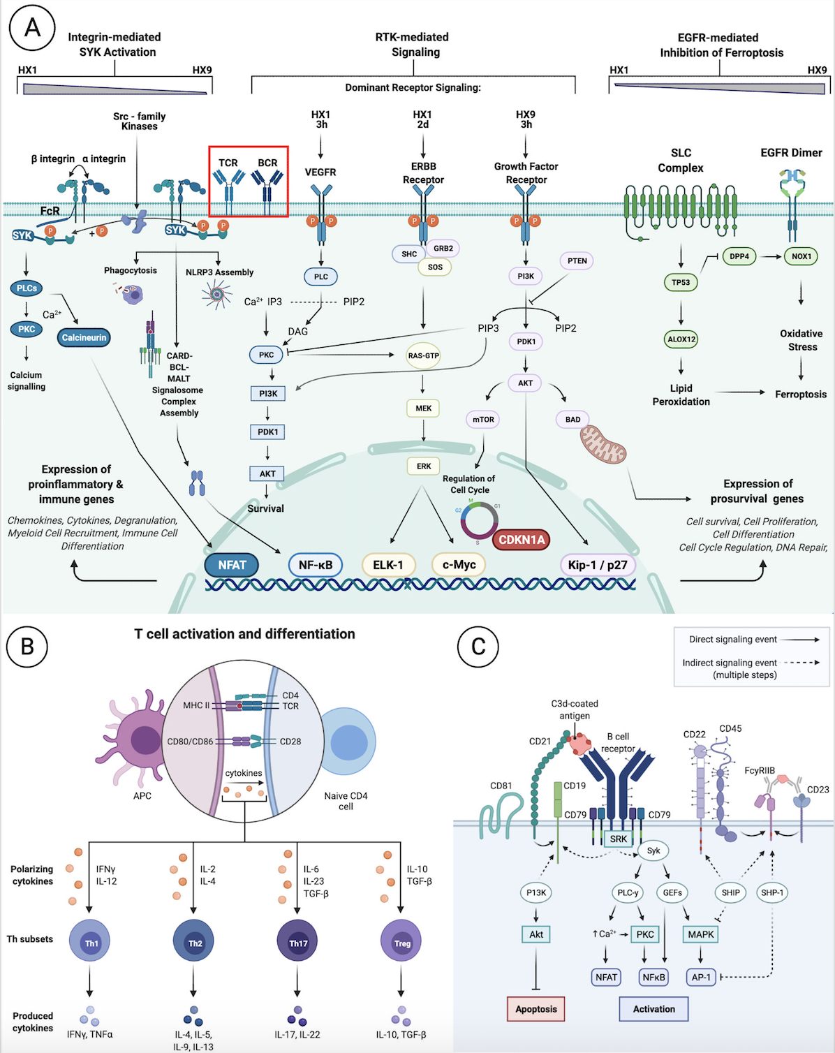
Figure 5. An integrated synthesis of potential signal transduction responses to repetitive (HX9) preconditioning.
Harman et al., Conditioning Medicine 2021; 4(1):58-68.

