Slide 1
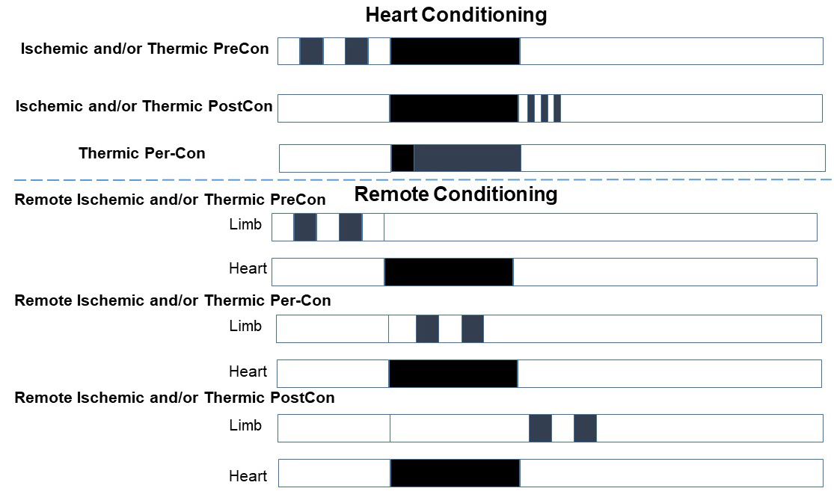
Figure 1. Schematic representation of the various protocols of ischemic or thermic conditioning.
Pasquale Pagliaro et al, Conditioning Medicine 2020; 3(1):31-46.

