Slide 1
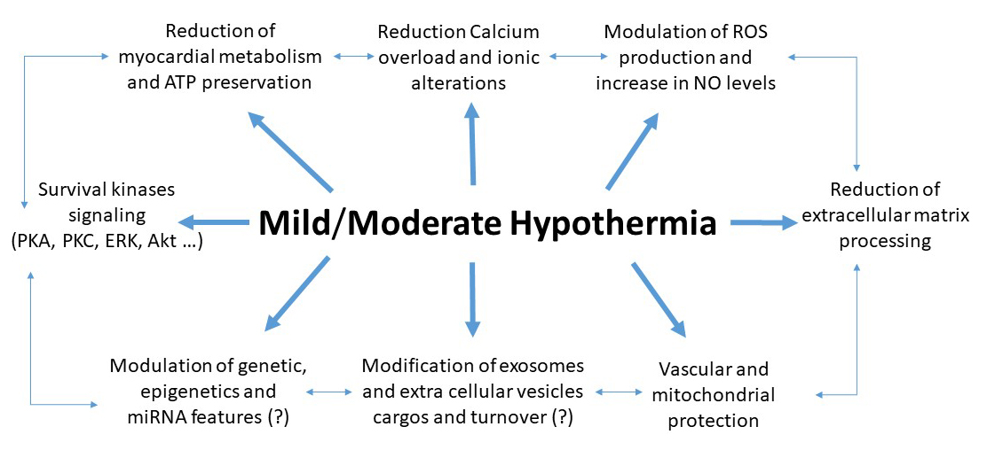
Figure 1. Main mechanisms of hypothermia induced cardioprotection. It is likely that these mechanisms are interconnected.
Pasquale Pagliaro et al, Conditioning Medicine 2020; 3(1):31-46.

