Slide 1
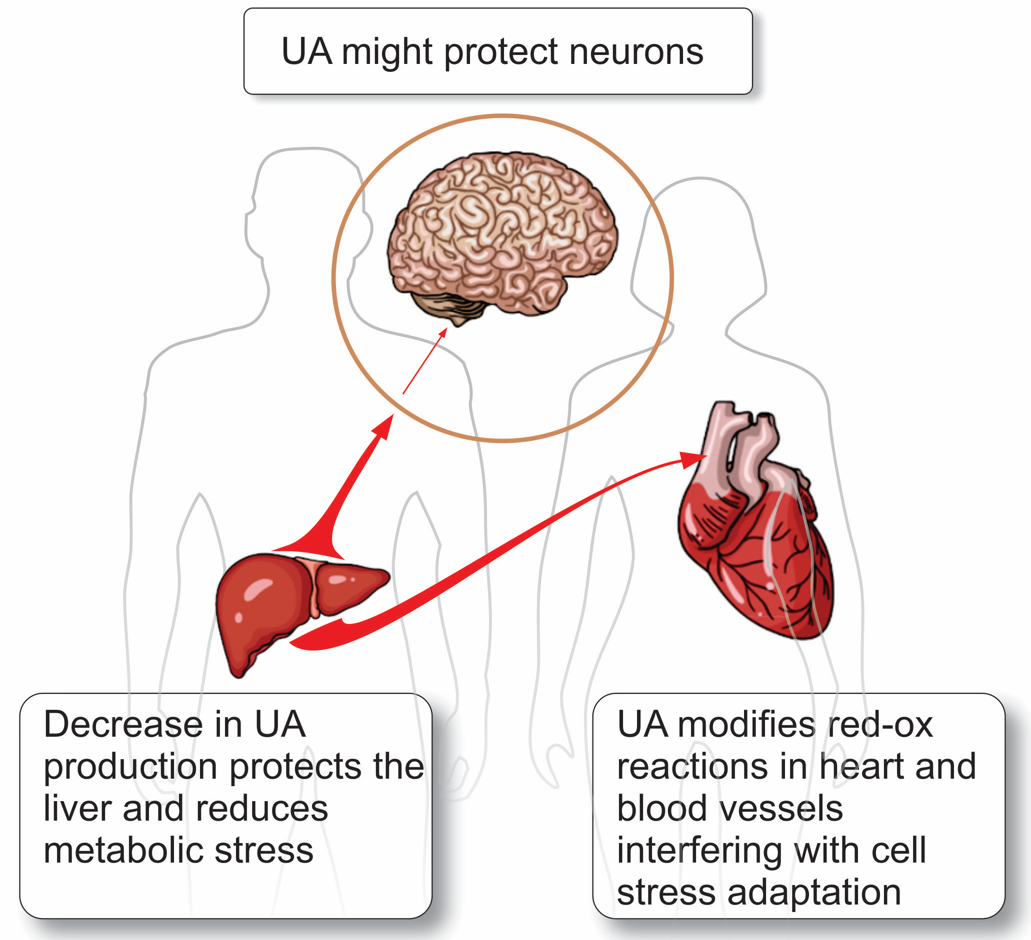
Figure 3. Three organs that differ in their response to UA and the role that UA play in these organs.
Ytrehus et al., Conditioning Medicine 2019; 2(1):40-49.

