Slide 1
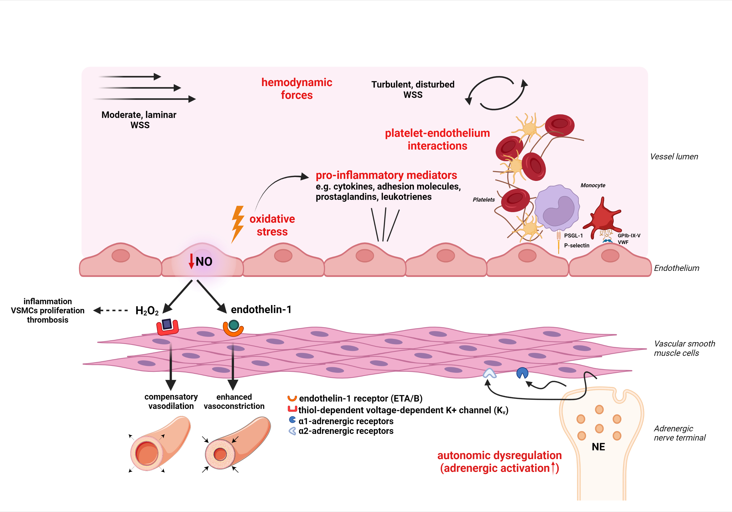
Figure 1. Schematic representation of four main mechanical, cellular and molecular effectors of coronary microvascular dysfunction (see respective module).
Lamprou et al, Conditioning Medicine 2022; 5(1):30-50.

