Slide 1
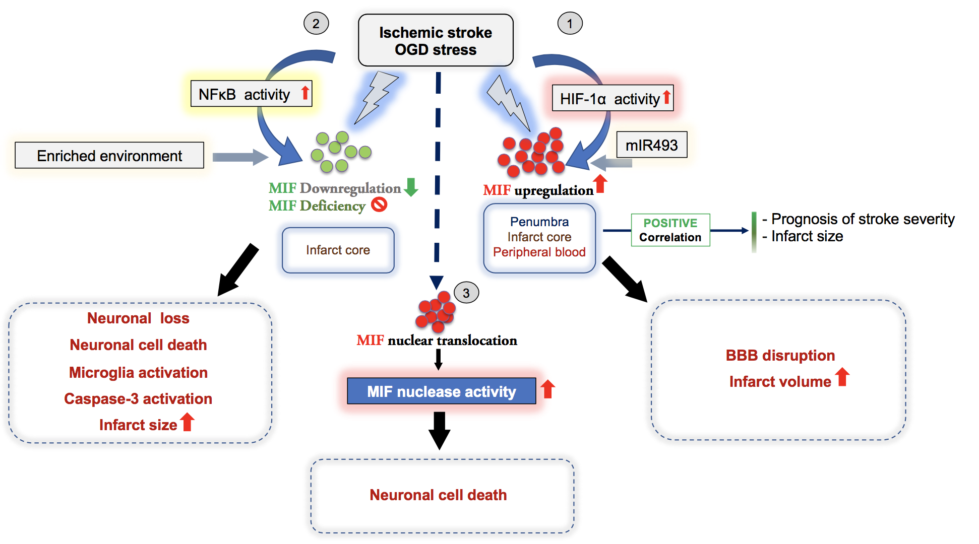
Figure 3. Overview illustrating the dichotomic effects and suggested mechanisms of the atypical chemokine MIF in ischemic stroke as evidenced by experimental and correlative clinical studies.
Wang et al., Conditioning Medicine 2021; 4(1):39-57.

