Slide 1
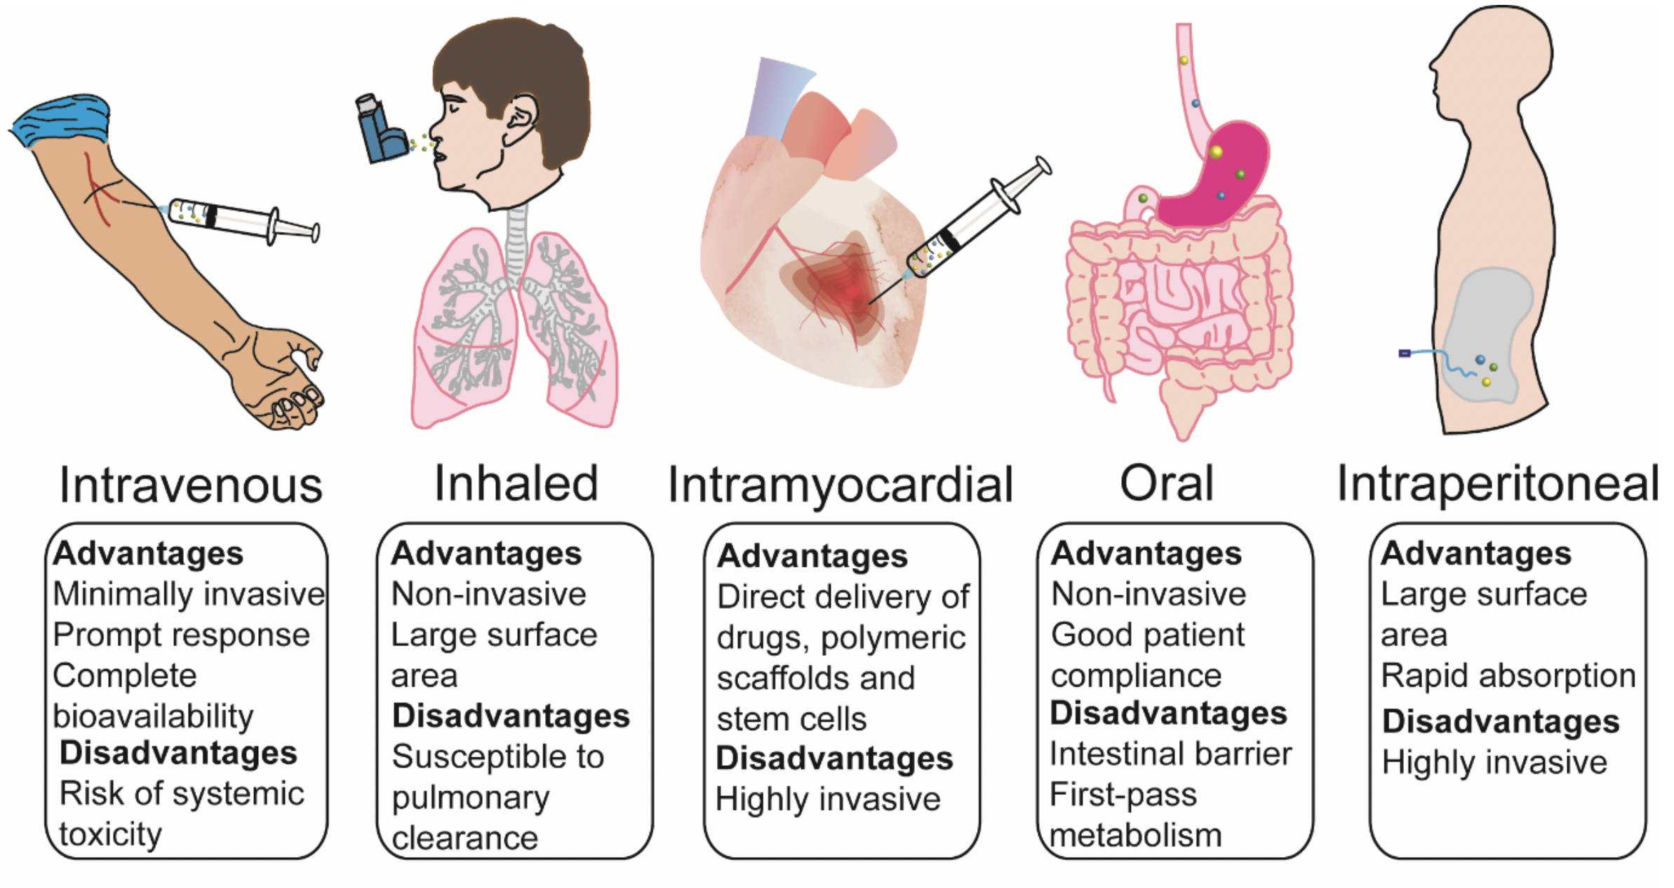
Figure 3. Potential routes of nanoparticle administration applied in cardiovascular disease - their advantages/disadvantages.
Abraham Mendez-Fernandez et al, Conditioning Medicine 2020; 3(1):18-30.

