Slide 1
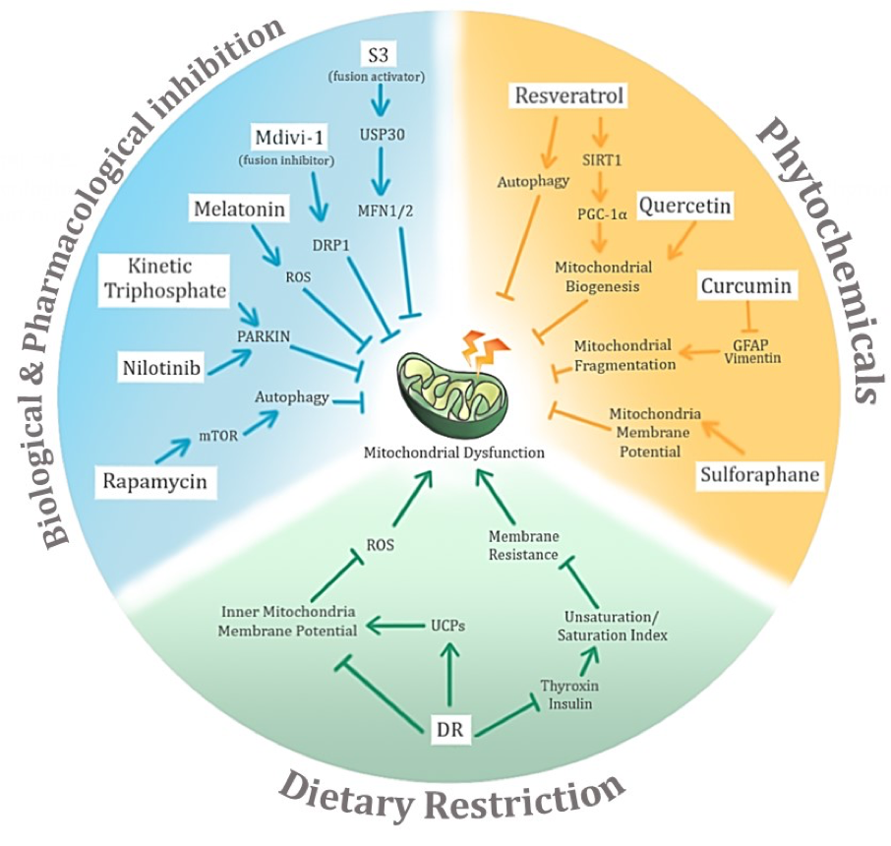
Figure 4. Potential avenues of negative conditioning of mitochondrial dysfunction in age-related neurodegenerative diseases and their associated potential mechanisms of action. The three main proposed modes of negative conditioning are biological and pharmacological inhibition, use of phytochemicals, and dietary restriction.
Selvaraji et al., Conditioning Medicine 2019; 2(1):30-39.

