Slide 1
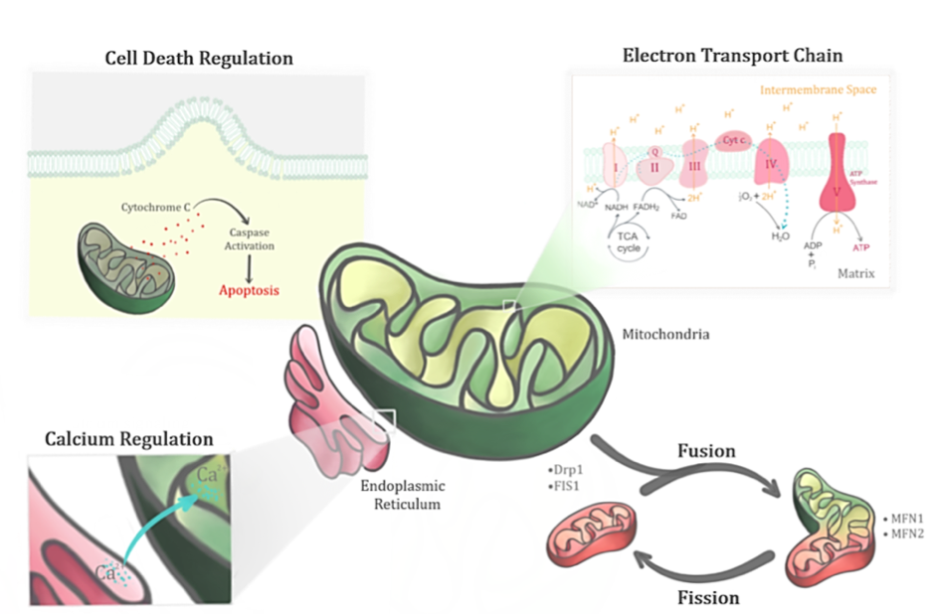
Figure 2. Mitochondrion, a dynamic organelle, has several important functions in its physiological state. Apart from its primary role in regulating the bioenergetics of the cell through the electron transport chain, it also regulates the fusion-fission cycles, calcium levels and cell death.
Selvaraji et al., Conditioning Medicine 2019; 2(1):30-39.

