Slide 1
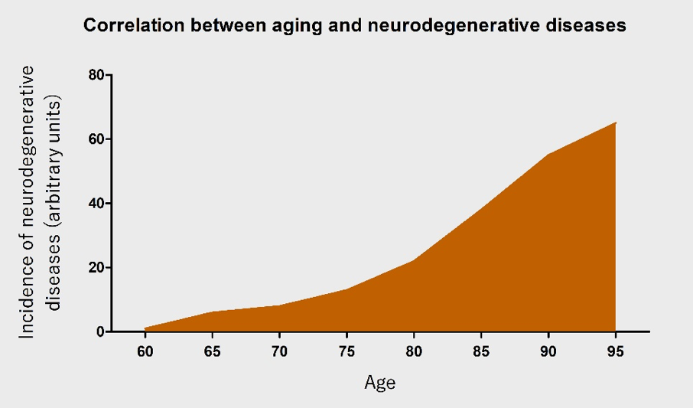
Figure 1. An illustration of the correlation between age and the occurrence of neurodegenerative diseases. With increasing age, the incidence of neurodegenerative diseases is posited to increase almost exponentially.
Selvaraji et al., Conditioning Medicine 2019; 2(1):30-39.

