Slide 1
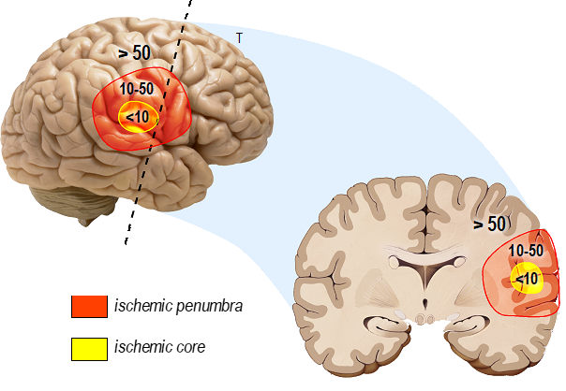
Figure 1.
Sophie Béraud-Dufour et al.; Conditioning Medicine 2024; 7(2): 69-80.

