Slide 1
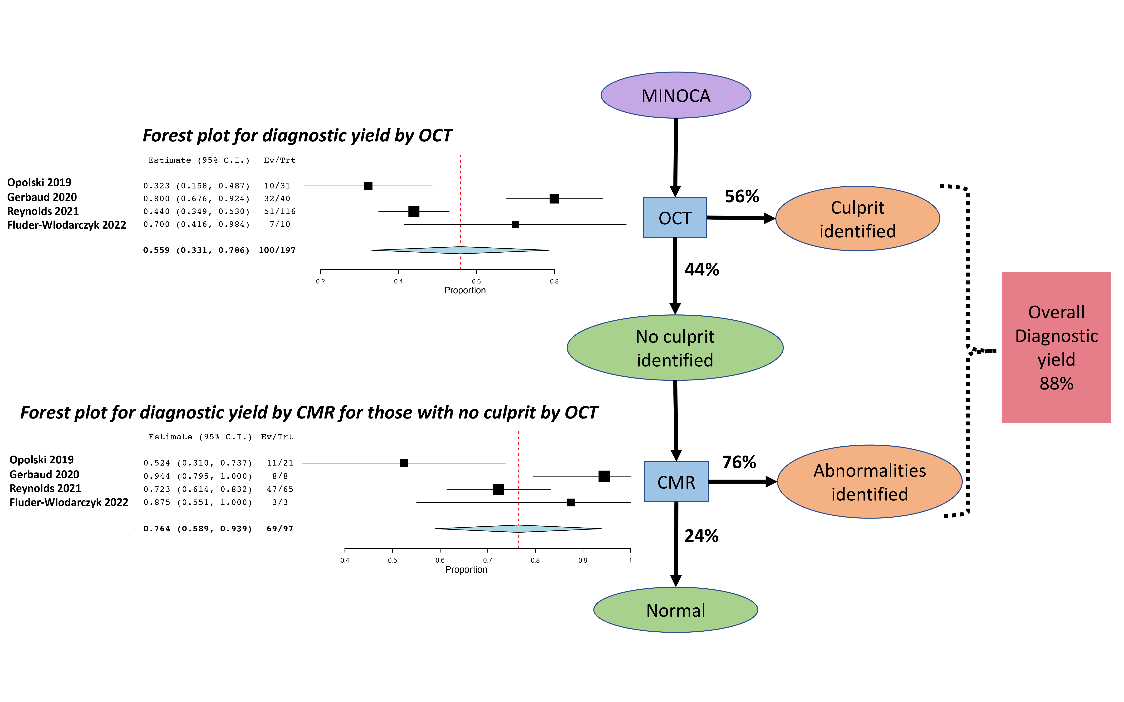
Figure 1.
Thirunavukarasu et al., Conditioning Medicine 2023; 6(1): 1-3.

