Slide 1
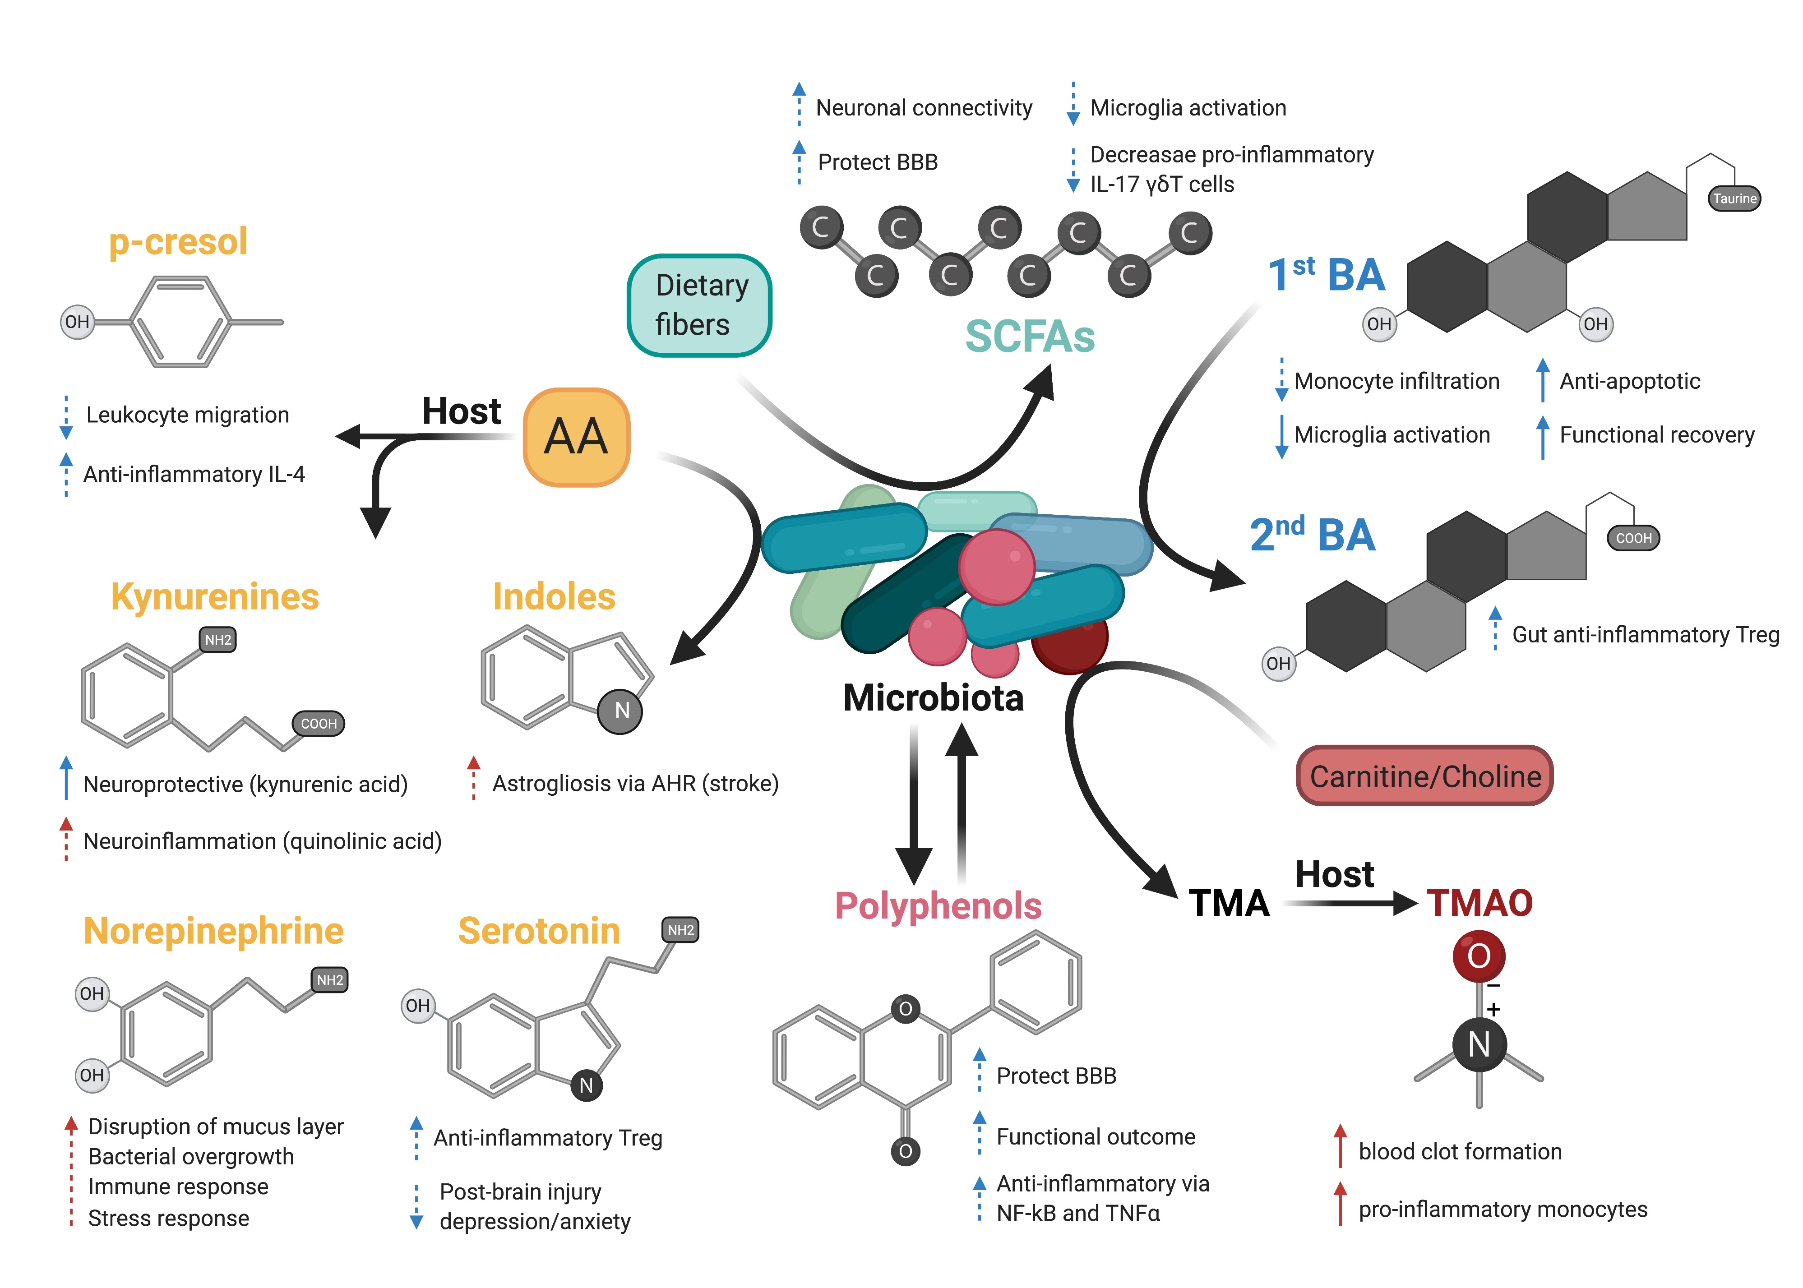
Figure 2. Possible effects of microbiota-derived metabolites on acute brain injury.
Fink et al., Conditioning Medicine 2021; 4(1):28-38.

