Slide 1
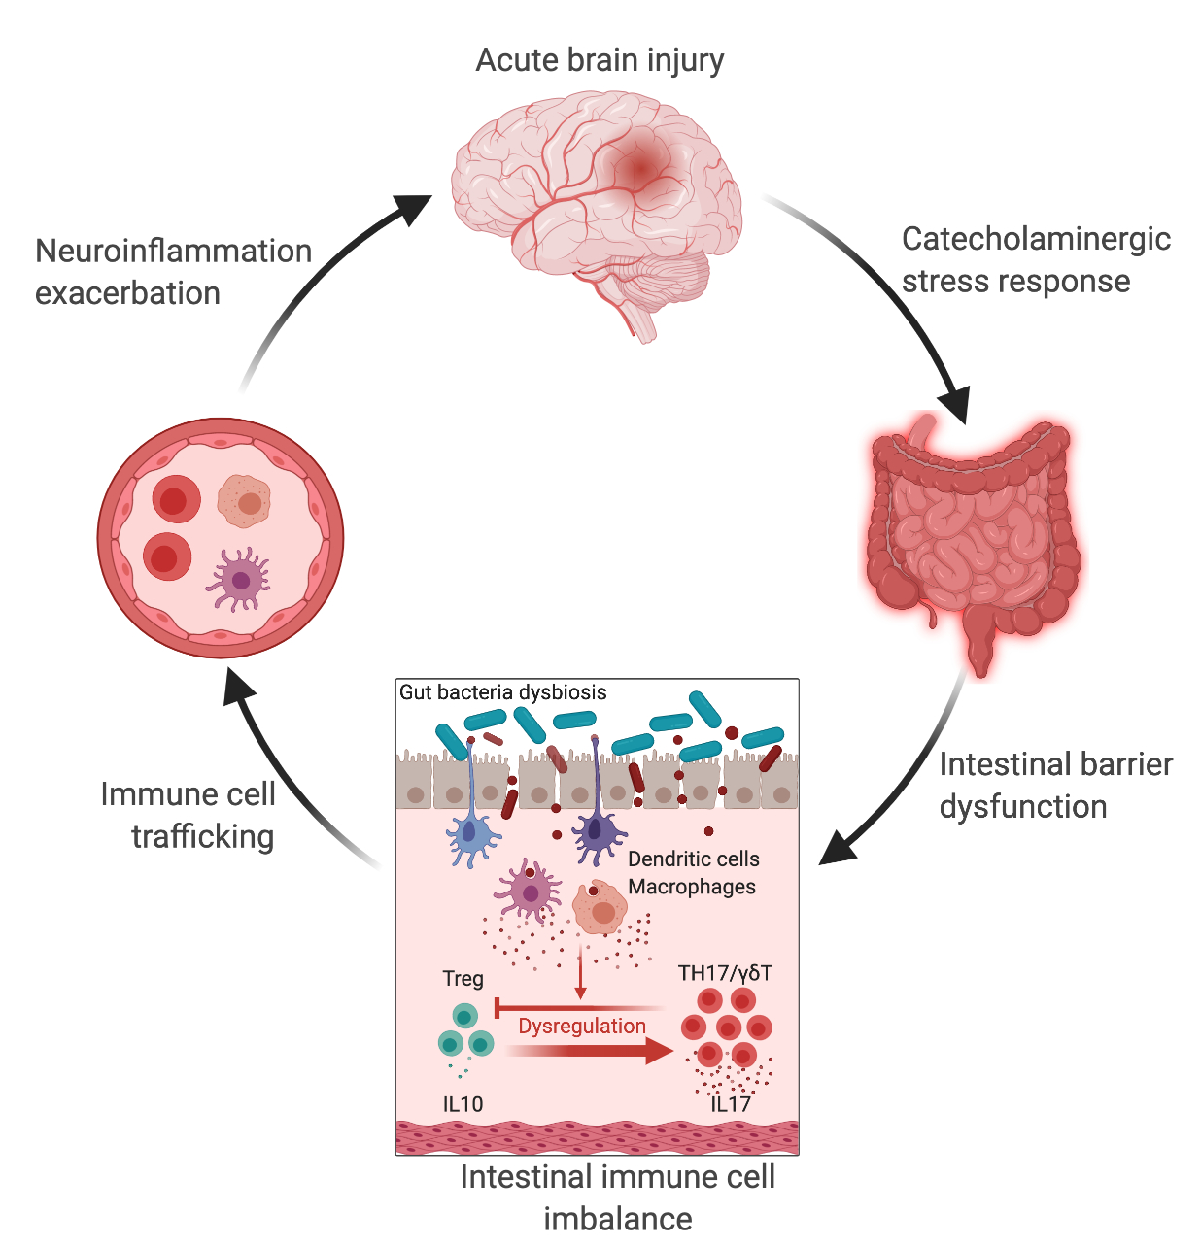
Figure 1. The gut-brain axis in acute brain injury. Acute brain injury induces microbiota dysbiosis and is associated with a stress response, intestinal barrier dysfunction, and immune imbalance.
Fink et al., Conditioning Medicine 2021; 4(1):28-38.

