Slide 1
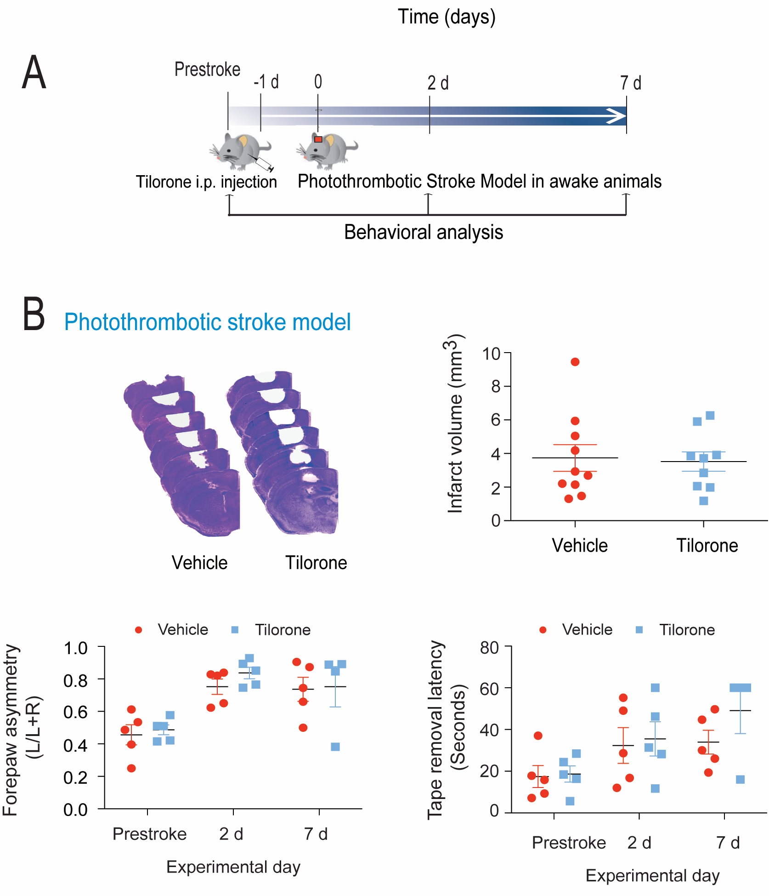
Figure 5. Tilorone preconditioning did not reduce infarct volume or behavioral deficits in a photothrombotic stroke model.
Yujia Zhai et al, Conditioning Medicine 2020; 3(1):1-8.

