Slide 1
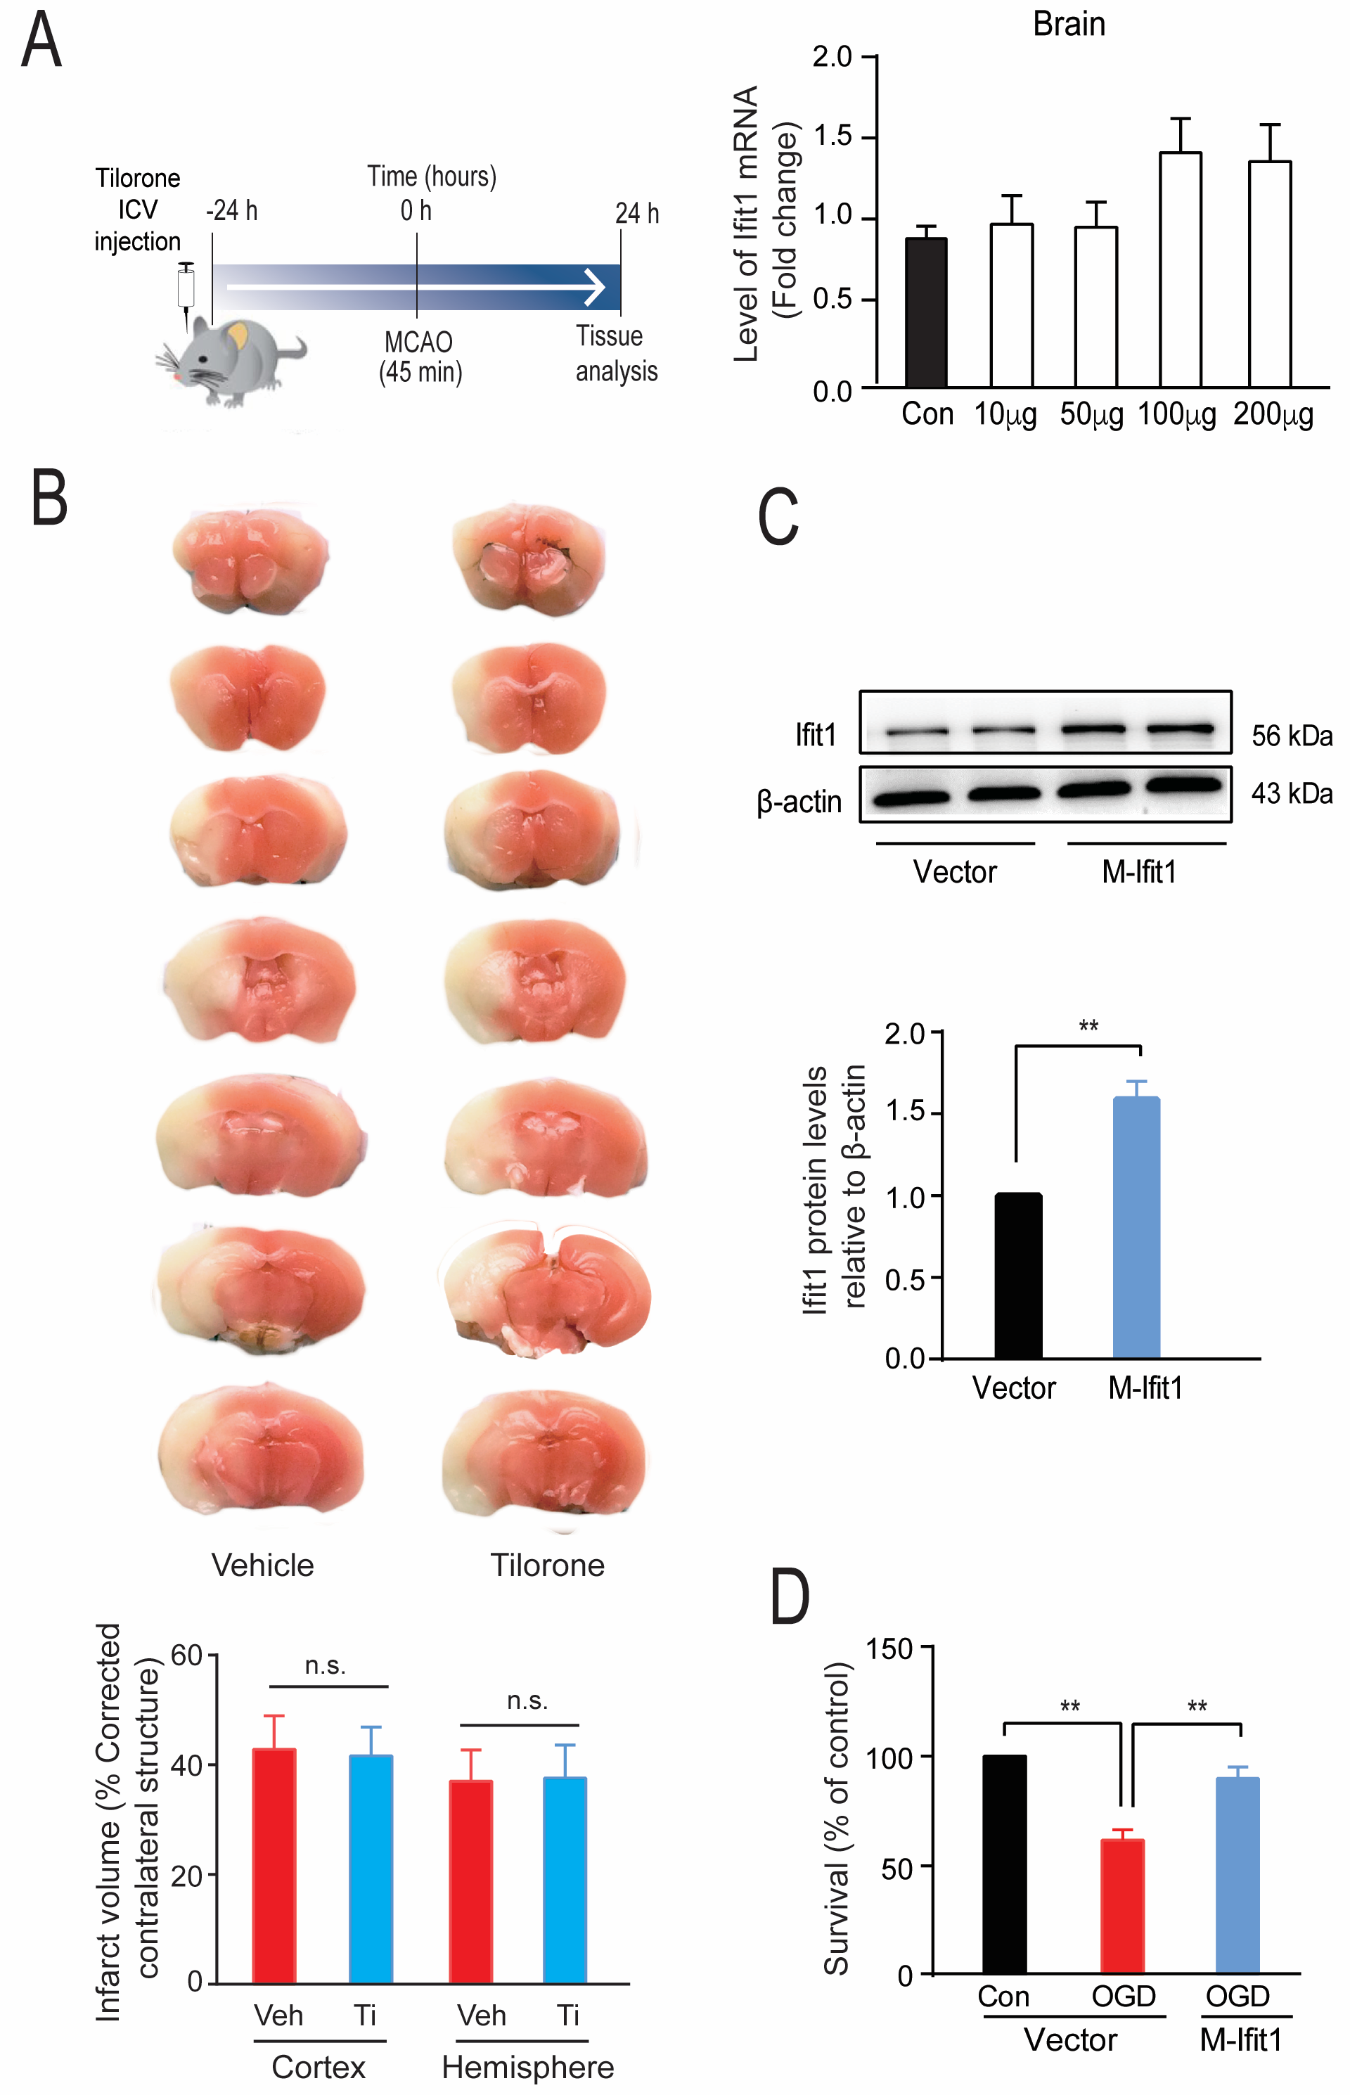
Figure 4. Intracerebroventricular (ICV) administration of tilorone does not reduce infarct size.
Yujia Zhai et al, Conditioning Medicine 2020; 3(1):1-8.

