Slide 1
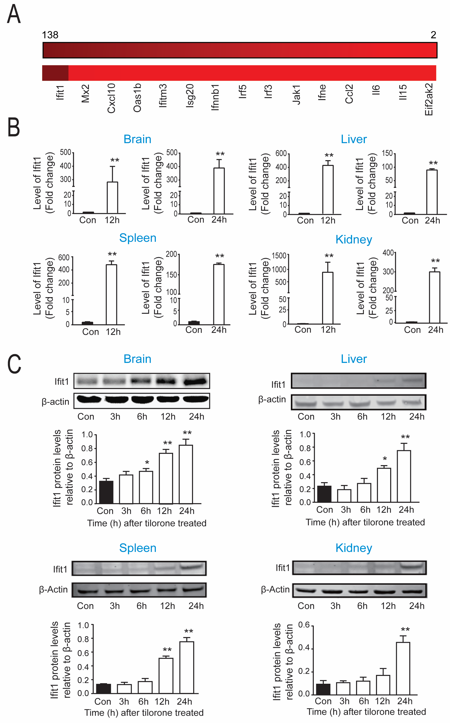
Figure 3. Tilorone preconditioning is correlated with increases in antiviral IFN stress response gene expression.
Yujia Zhai et al, Conditioning Medicine 2020; 3(1):1-8.

