Slide 1
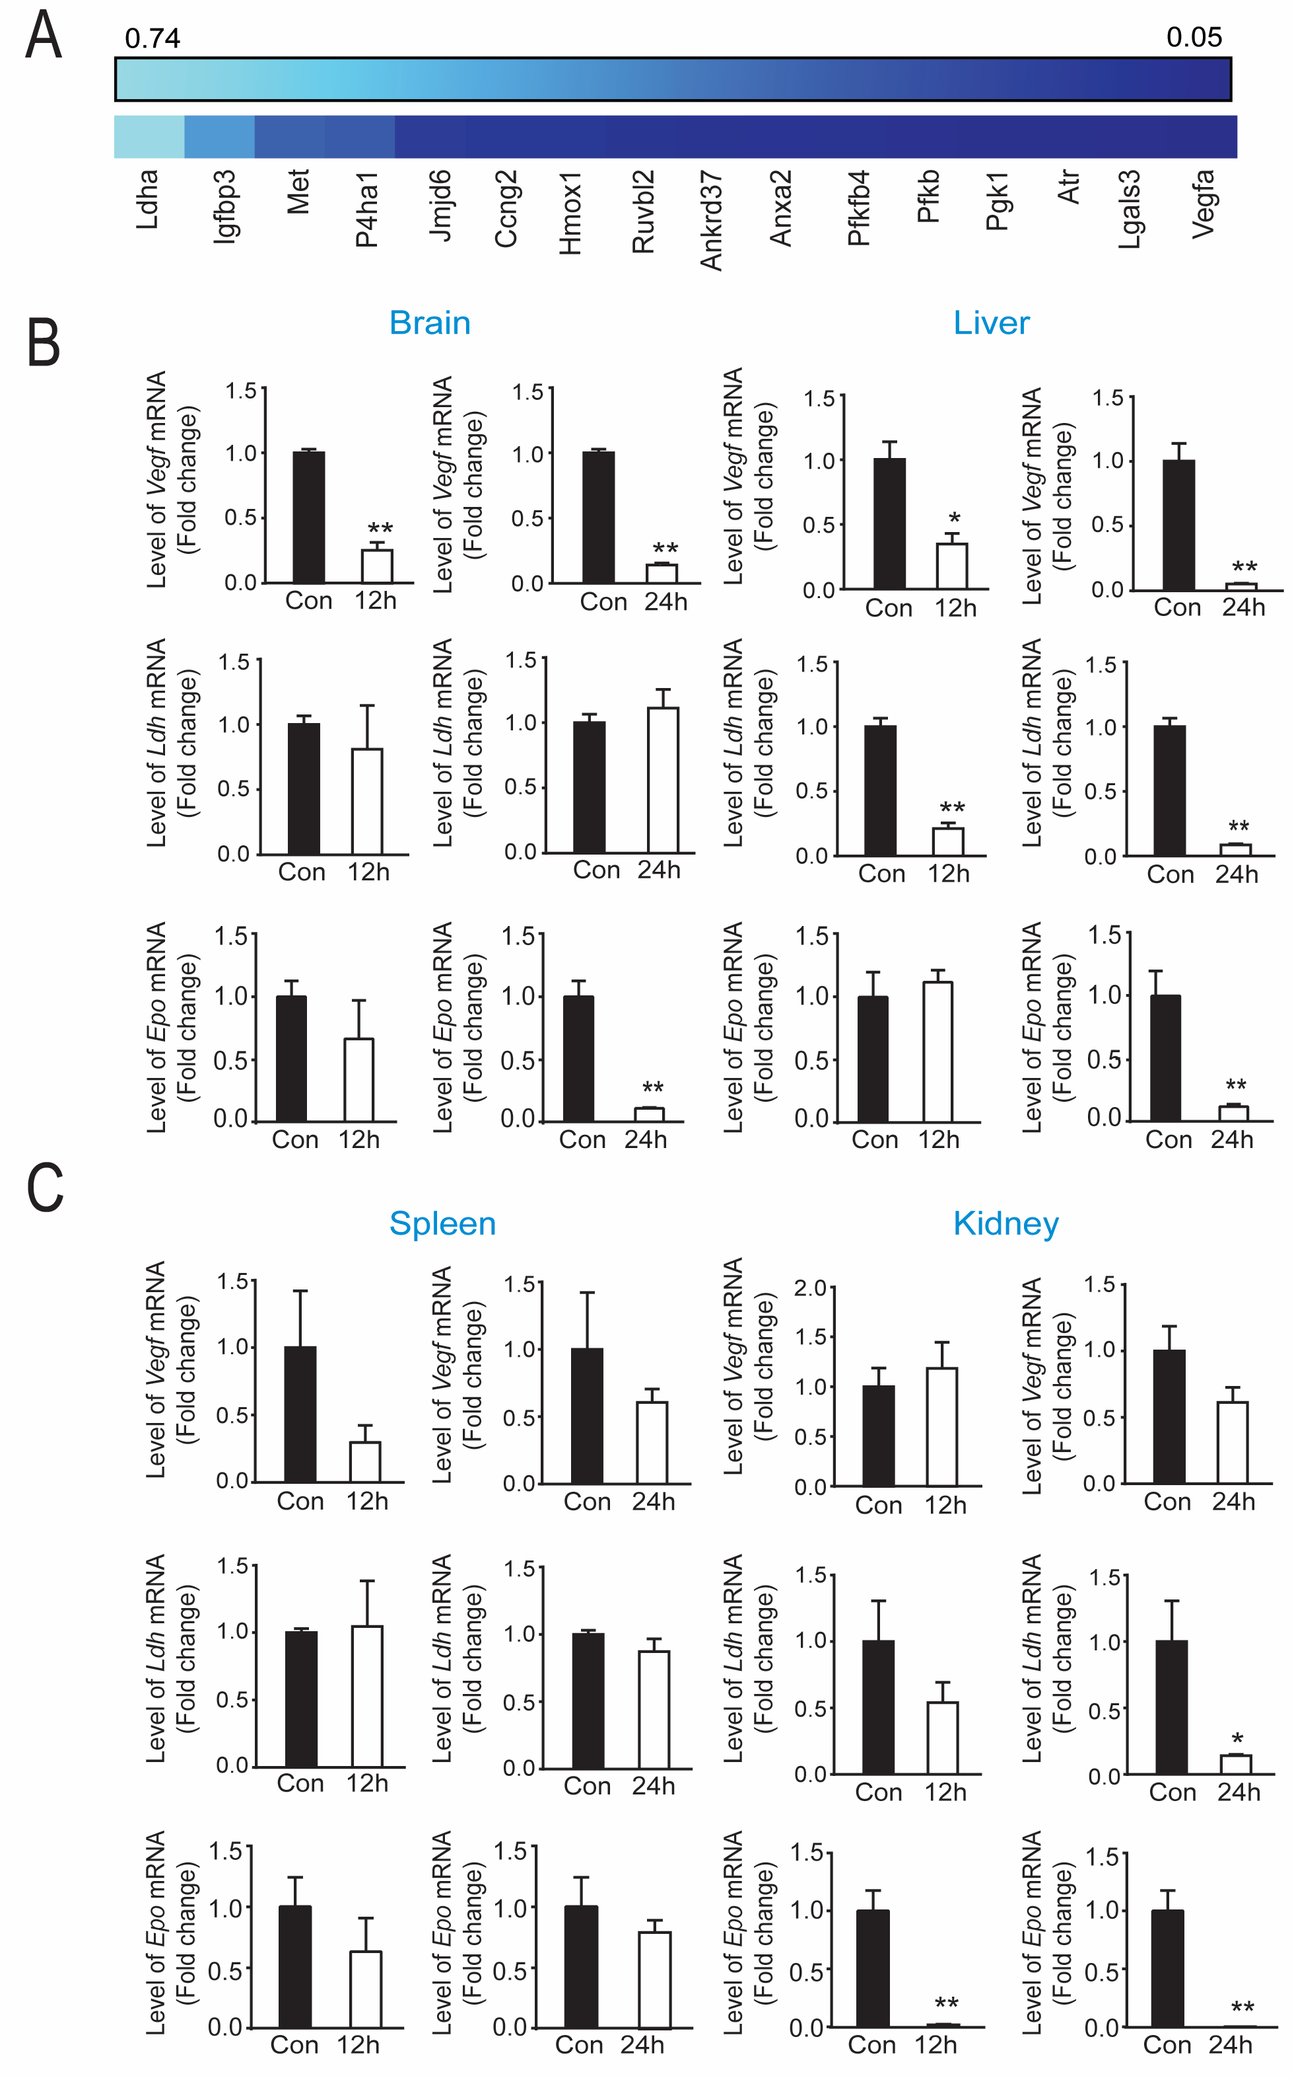
Figure 2. Protective levels of tilorone downregulates hypoxia inducible factor (HIF) associated gene expression in vivo.
Yujia Zhai et al, Conditioning Medicine 2020; 3(1):1-8.

