Slide 1
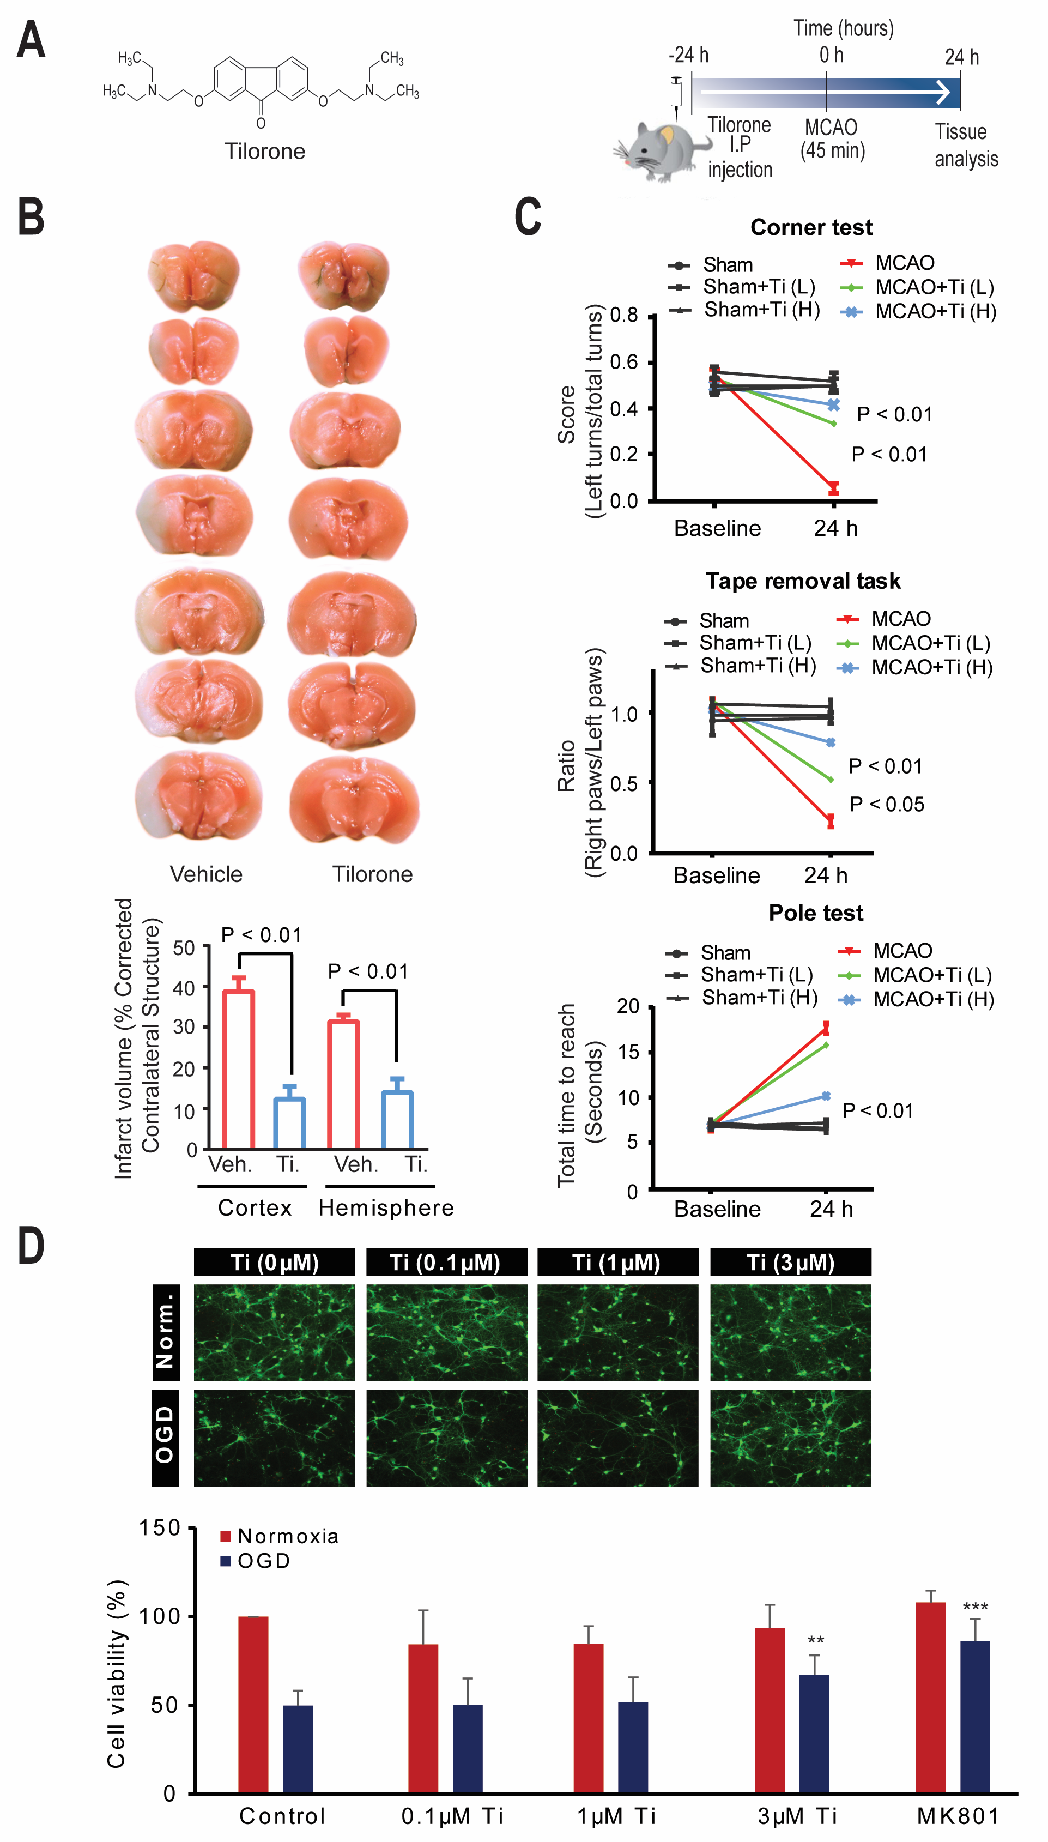
Figure 1. Pre-treatment with tilorone can precondition against stroke-induced damage and behavioral dysfunction in mice.
Yujia Zhai et al, Conditioning Medicine 2020; 3(1):1-8.

