Slide 1
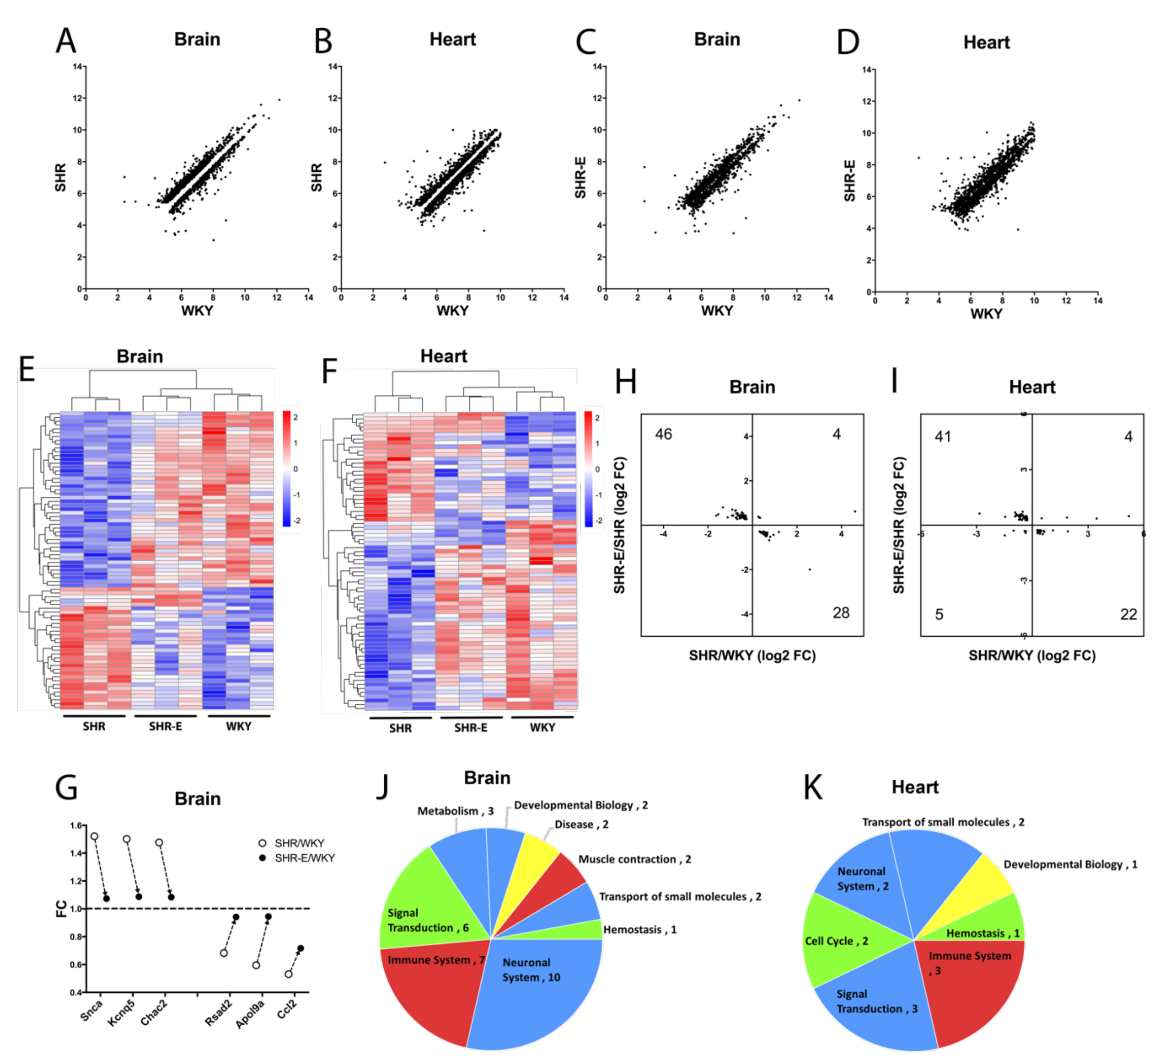
Figure 7.
Lan et al., Conditioning Medicine 2019; 2(1):50-61.

