Slide 1
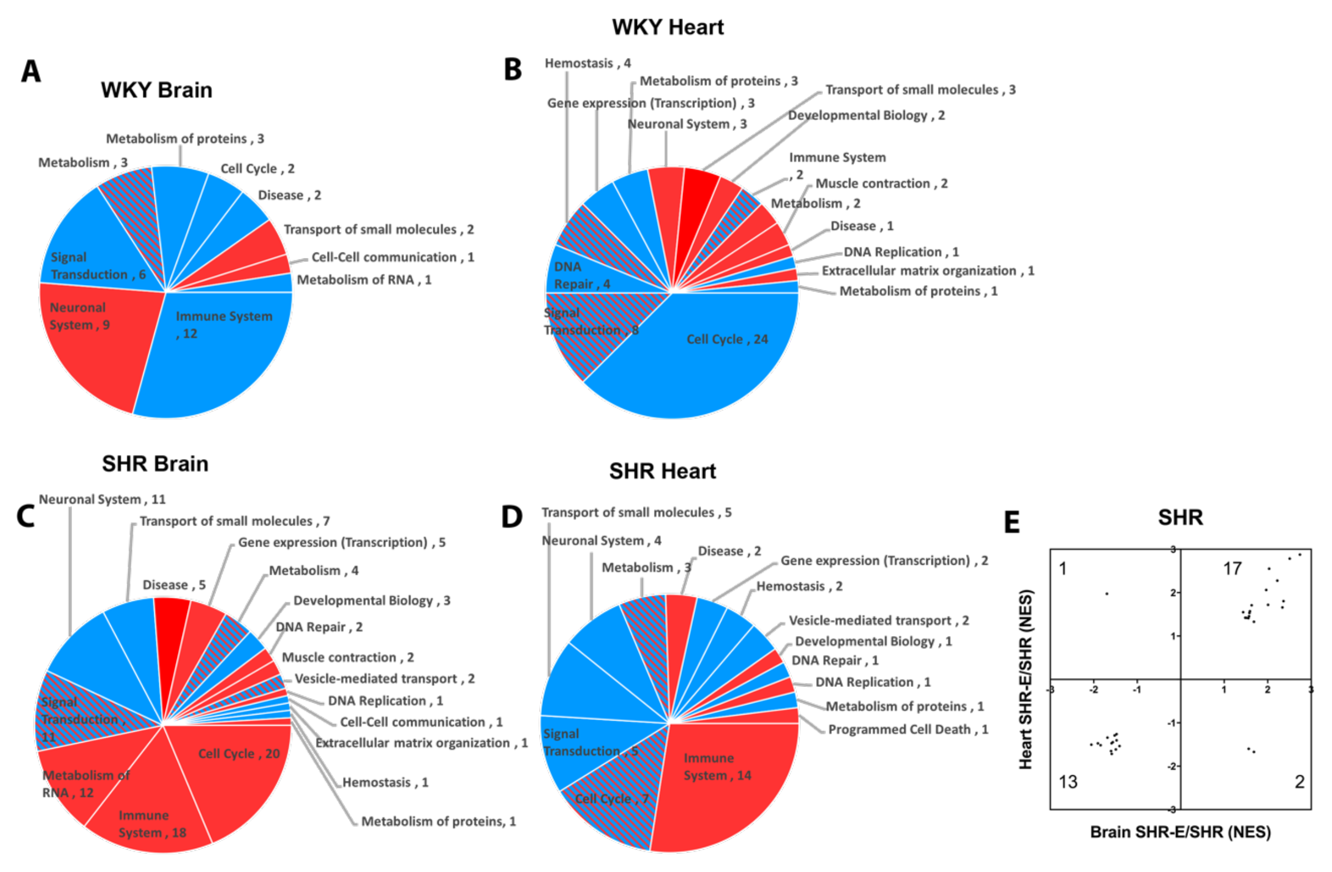
Figure 6. Pie chart of exercise-induced Reactome pathways in (A) brain and (B) heart of WKY, and in (C) brain (C) and (D) heart of SHR; red for upregulation, blue for downregulation, and shaded for mixed directions of change. (E) Distribution of change directions in exercise-induced common Reactome pathways in brain and heart vasculomes of SHR.
Lan et al., Conditioning Medicine 2019; 2(1):50-61.

