Slide 1
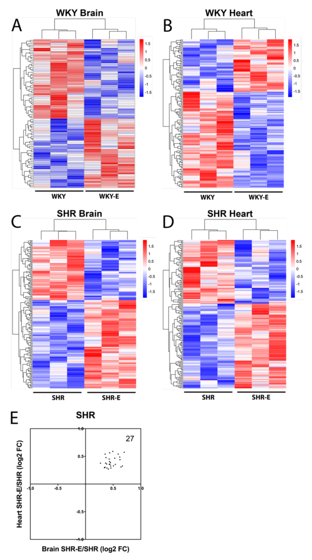
Figure 5. Vasculome heatmap of exercise-induced DEGs in (A) brain and (B) heart of WKY, and in (C) brain and (D) heart of SHR. (E) Distribution of fold-change directions in exercise-induced common DEGs in brain and heart vasculomes of SHR.
Lan et al., Conditioning Medicine 2019; 2(1):50-61.

