Slide 1
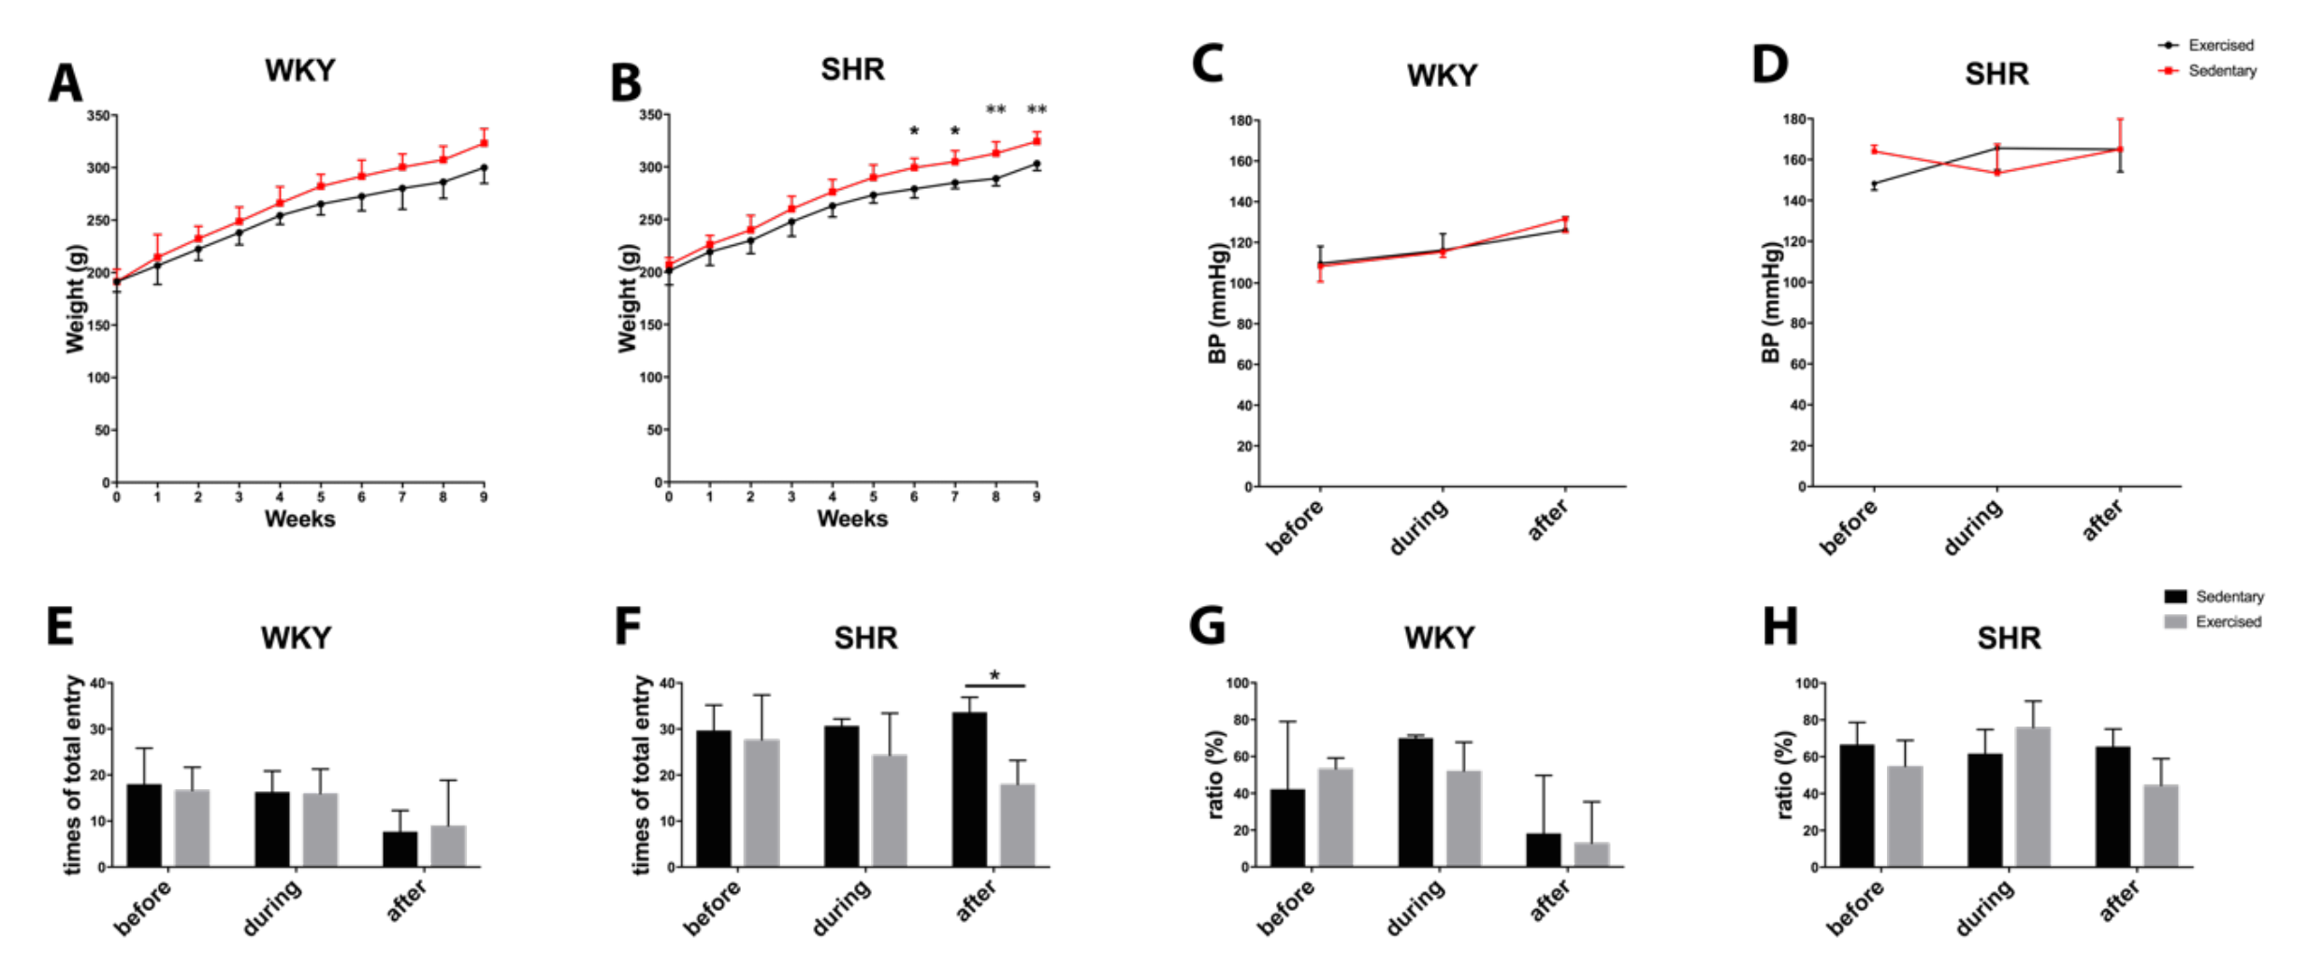
Figure 4: Body weight during the process of exercise in (A) normotensive WKY and (B) hypertensive SHR. Blood pressure during the process of exercise in (C) normotensive WKY and (D) hypertensive SHR. Total entry numbers in Y-maze test for (E) WKY and (F) SHR. Ratio of correct entry (percentage) in Y-maze for (G) WKY and (H) SHR. * for p < 0.05 and ** for p < 0.01.
Lan et al., Conditioning Medicine 2019; 2(1):50-61.

