Slide 1
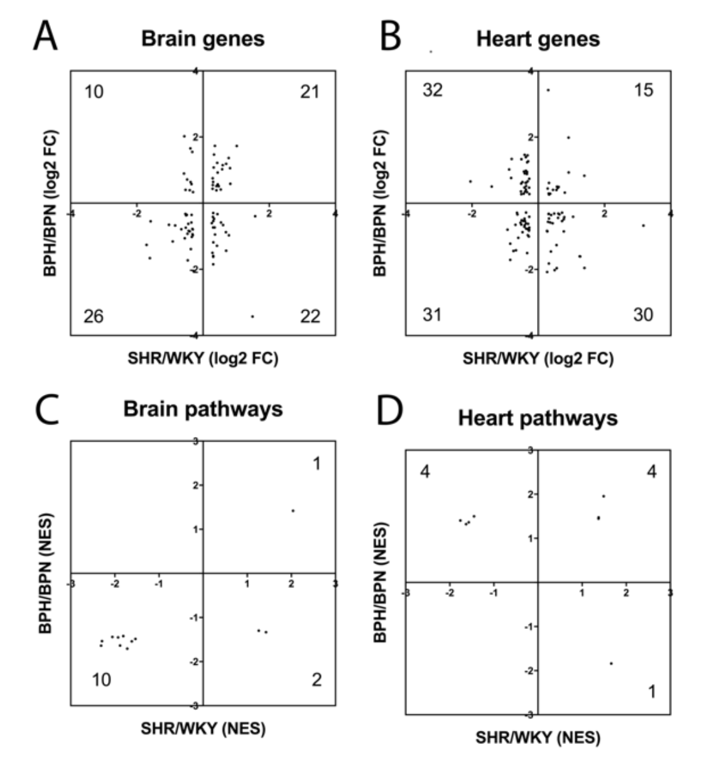
Figure 3: Distribution of fold-change directions for common hypertension DEGs in SHR-vs-WKY and BPH-vs-BPN in (A) brain and (B) heart. Distribution of change directions for hypertension-induced common Reactome pathways in SHR-vs-WKY and BPH-vs-BPN in (C) brain and (D) heart.
Lan et al., Conditioning Medicine 2019; 2(1):50-61.

