Slide 1
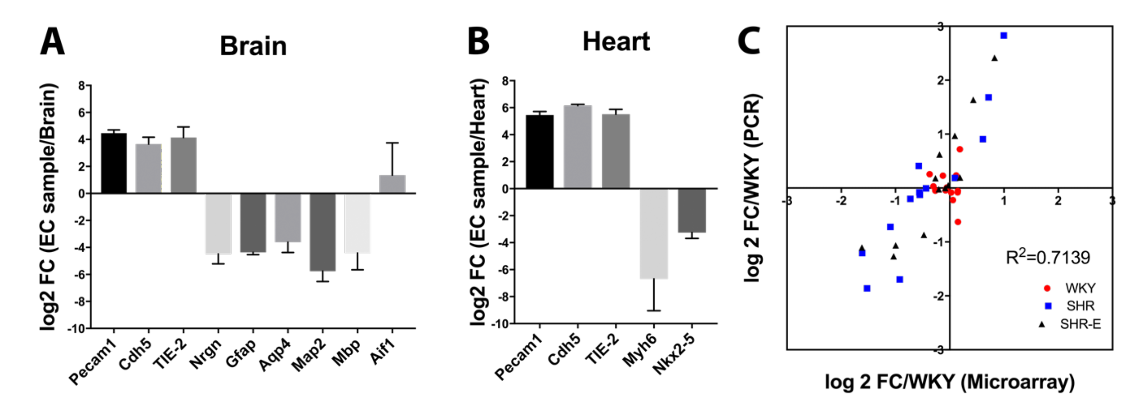
Figure 1. Comparison of different cell type markers between endothelial cell samples and their original organ tissue in (A) brain or (B) heart. (C) Comparison of some differentially expressed genes between RT-PCR and microarray results.
Lan et al., Conditioning Medicine 2019; 2(1):50-61.

