Slide 1
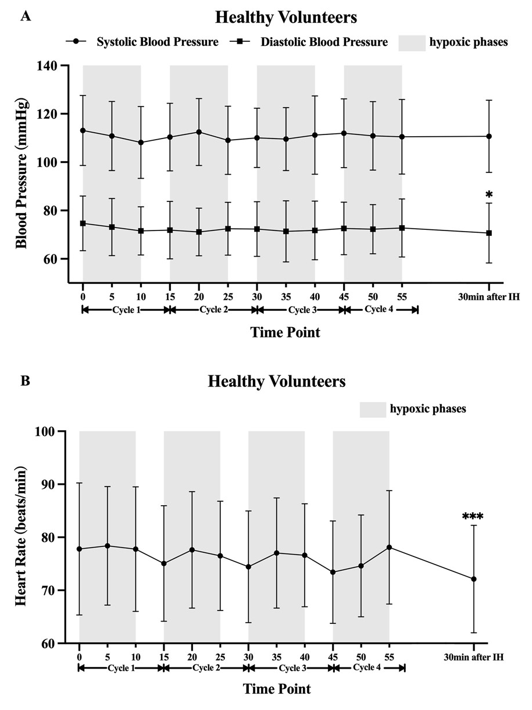
Figure 2.
Wang et al., Conditioning Medicine 2023; 6(1): 4-10.

