Slide 1
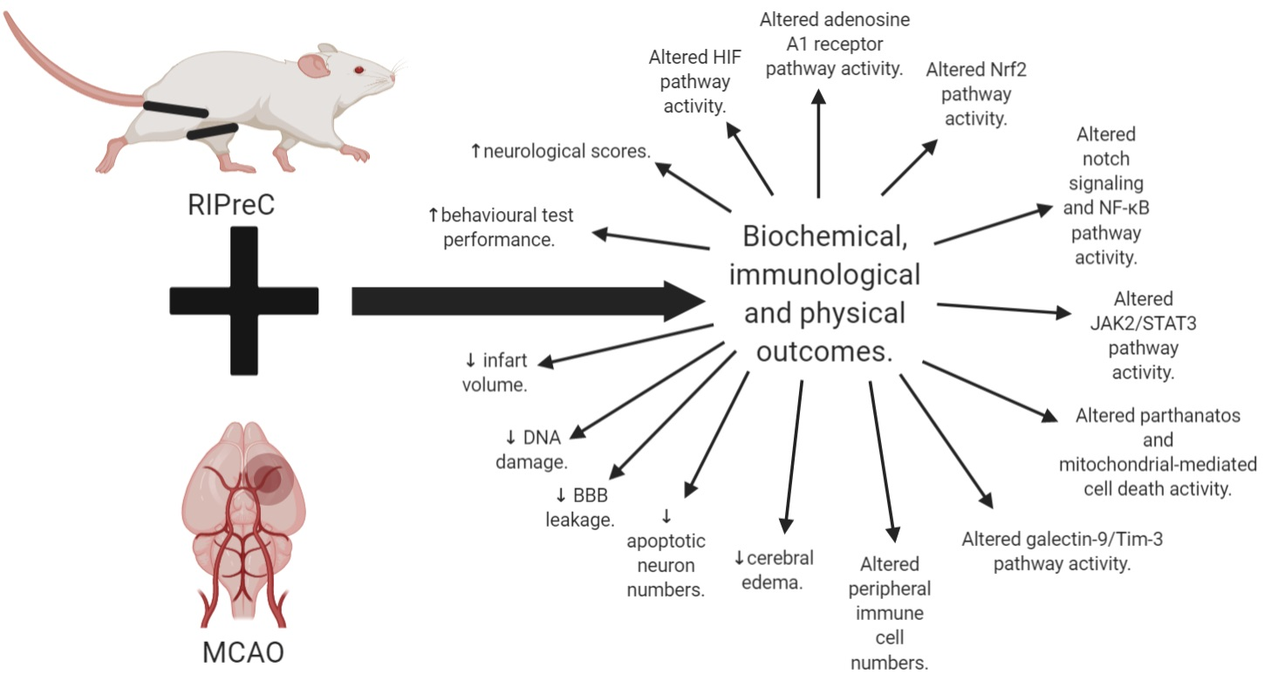
Figure 3. Summary of all the biochemical, immunological, and physical outcomes of RIPreC with MCAO as compared to MCAO without RIPreC.
Schmidt et al., Conditioning Medicine 2021; 4(1):15-27.

