Slide 1
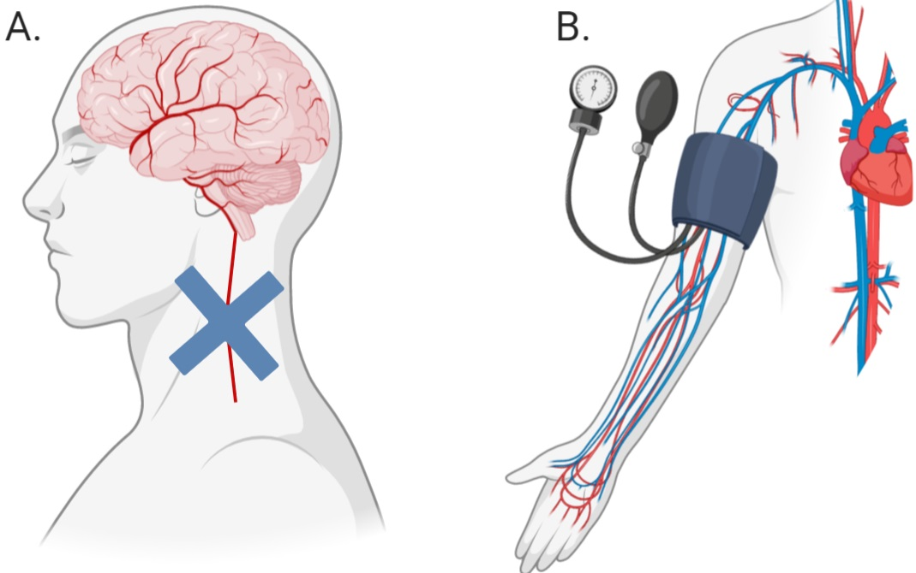
Figure 1. Difference between ischemic conditioning (A) and remote ischemic conditioning (B). Blue cross (A) indicates the application of a device to occlude blood flow.
Schmidt et al., Conditioning Medicine 2021; 4(1):15-27.

