Slide 1
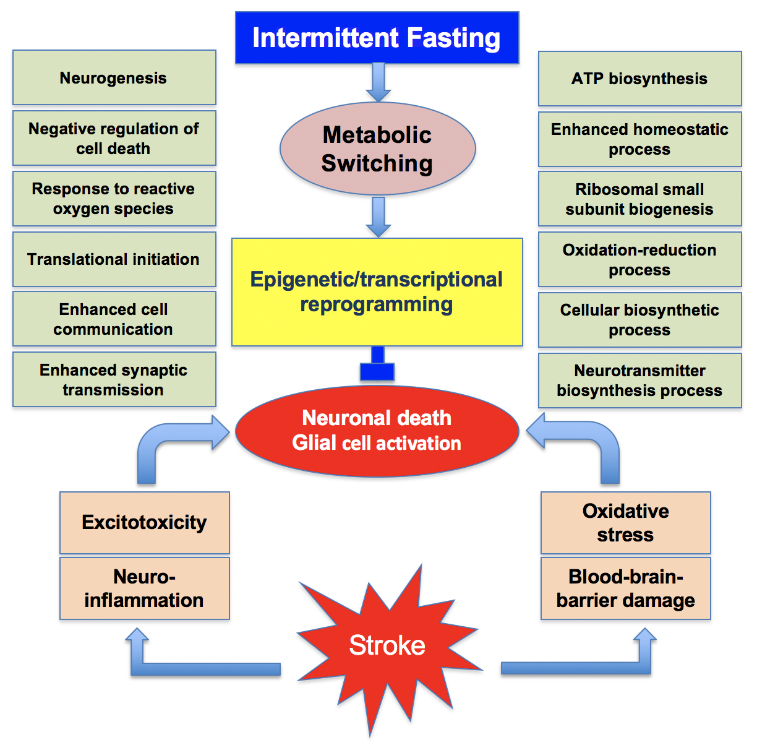
Figure 1. Many synergistic pathological events that include excitotoxicity, neuroinflammation, oxidative stress and blood-brain barrier damage promote the post-stroke brain damage.
Raghu Vemuganti and Thiruma V. Arumugam, Conditioning Medicine 2020; 3(1):9-17.

